Slide 1
IEEE Member and Geographic Activities in 2025
Antonio Luque, Vice President & Drew Lowery, VP-Elect
Region 5 Meeting, Wichita, Kansas,
29 March 2025

Slide 2
About me
Engineer. Educator. Innovator.
A snapshot outside IEEE
Currently
Senior Systems Engineer, Volvo Group, Hagerstown, MD
Avid traveler, photographer
Previously
Lead Scientist for University spin-off start-up company, Morgantown, WV
Adjunct Professor and Visiting Scholar, West Virginia University
A snapshot within IEEE
Region 2 Director, 2023-2024
IEEE Board of Directors
Committee / Leadership Continuity, 2024
IEEE MGA
Committee / Region Realignment, 2023-2024
Committee / Training, 2024
Committee / Local Unit Risk, 2024
IEEE TA
Committee / Entrepreneurship, 2017
IEEE EA
Committee / IEEE-HKN Journey Mapping, 2019-2024
Committee / IEEE-HKN Young Alumni, 2019-2024
Committee / IEEE-HKN Conference, 2024
IEEE-USA

Slide 3
What does MGA do?

Slide 4
Topics for MGA in 2025
Membership
Transition of students to industry. Continuation of Catalyst efforts
Better connection of SBs and students with the rest of IEEE
Focus on industry members
GeoUnits
Assets
Compliance
Elections
Changes in rebates and dissolutions
IEEE
One IEEE
New IEEE budget process. Implications for MGA and GeoUnits
New TSCMO
MGA
More data-based decisions
Improve diversity in awards and nominations
More training, onboarding of volunteers. Involvement of MGA representatives
Compliance and removal process. Disciplinary lists
Deploy a committee review process
Events
Road to Sections Congress 2026. Event in 2025
Returning of WIE ILC
2nd LM Conference
Mini-series
Joint SAC/WIE/YP/LM meeting
CleanTech summit
2025 MGA AdHoc Committees
Governance
Reaching new audiences
Conferences

Slide 5
MGA Strategic Plan

Slide 6
Notes:
03/11/2024
6

Slide 7
IEEE Affinity Groups @ 31 December 2024
TOTAL Student Members: 189,717
10.9% Increase YoY
TOTAL Life Members: 38,916
3.1% Increase YoY
IEEE YP Membership: 134,736
6.1% Increase YoY
IEEE WIE Membership: 51,455
9.5% Increase YoY
IEEE PROPRIETARY

Slide 8
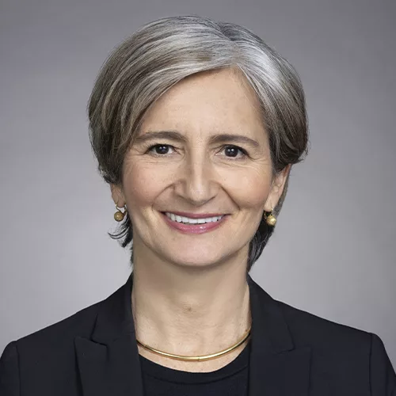
2025 WIE International Leadership Conference (ILC)
Confirmed Keynote Speakers
Michaela Blott
Senior Fellow
AMD
Alessandra Costa Senior Vice President
Synopsys
San Jose, CA, USA | 15 - 16 May 2025
Notes:
After a two year hiatus, the IEEE WIE International Leadership Conference is back this May with a timely and inspiring theme: 'Accelerating Women in Technology: Leadership in an AI-Powered World.

Slide 9
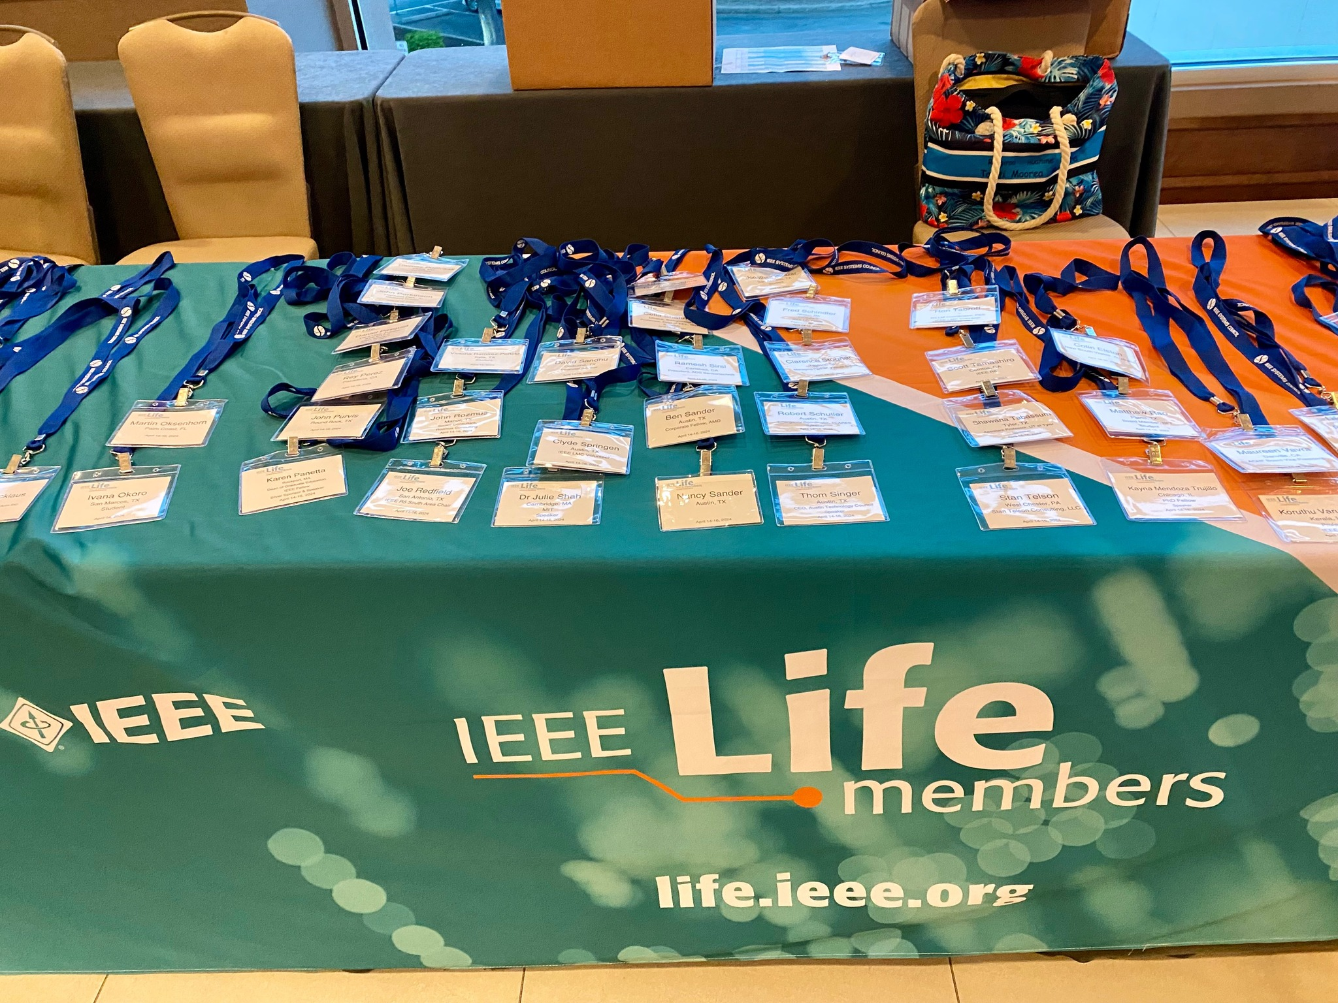
2025 Life Members Conference
Boston, MA USA | 11-13 June 2025
Conference Areas of Interest
From thought-provoking keynote speeches and topical sessions to engaging workshops and panel discussions—the 2025 conference will be organized around three types of technological evolution:
Technology that creates product opportunities
Applications that impact the lives of seniors and the aging population
Contributions of IEEE members that are made by seniors and experienced professionals
Venue: Tufts University

Slide 10
How can you help MGA?

Slide 11
Opportunities in MGA & Regions
Membership
MELCC, A&A, ARC, Life Members, Students, WIE, YPs, Member Recruitment and Recovery
Geographic Activities
Geo Unit Operations, Chapter Operations, Sections Congress
Information Management
IT Coordination & Oversight, vTools
Operations
Training, N&A, Member Benefits, Finance
Skills Needs
Leader/Manager skills and experience
Individual contributors – Organizing, marketing, info management, develop and lead training programs
Flexible volunteering schedules
Nominations recruitment for MGAB and Region - Awards and positions
Data analysis for program and activity planning
+ More
A Year in MGA
Many moving parts – ~500K members, 13K+ geounits, global reach, local touch drives the need for connections and communications
IEEE scope and size drives the need for increased visibility into local operations – assets, compliance
2025-2030 IEEE strategy focused on One IEEE

Slide 12
Call for Nominations
Cycle 1 Deadline: 15 March 2025
2026 MGA Vice President-Elect/MGA Board Chair-Elect
2026 MGA Treasurer
2026 MGA Vice Chairs
2026 MGA Committee Chairs
Cycle 2 Deadline: 1 August 2025
2026 MGA Committee Members
2026 MGA Liaisons appointed by VP-MGA
IEEE Admission and Advancement Committee
MGA Awards and Recognition Committee
MGA Chapter Operations Support Committee
MGA Geographic Unit Operations Support Committee
MGA ieee.tv Advisory Committee
MGA IT Coordination and Oversight Committee
IEEE Life Members Committee
MGA Member Benefits Portfolio Advisory Committee
MGA Nominations and Appointments Committee
MGA Operations Manual Compliance Committee
MGA Potentials Editorial Board
MGA Strategic Planning Committee
MGA Student Activities Committee
MGA Training Committee
MGA vTools Committee
IEEE Women in Engineering Committee
IEEE Young Professionals Committee
Nominate yourself or a colleague now!
For questions, email mga-noms@ieee.org

Slide 13
Call for 2025 MGA Awards Nominations
All award recipients are announced after June and November MGAB meetings
Deadline: 15 May 2025
•Outstanding Section Awards (Large, Medium, and Small Section Award)
Deadline: 15 September 2025
•Individual Awards – Call for nominations planned for June 2025
- Larry K. Wilson Transnational Award
- IEEE MGA Diversity & Inclusion Award
- Innovation Award
- Leadership Award
- Achievement Award
- Young Professionals Achievement Award
•Friend of IEEE MGA Award (Individual & Organizational)
- Nominations accepted all year long!
- ARC reviews qualifying nominations at each selection meeting (June & November)
For questions, email mga-awards@ieee.org or visit https://mga.ieee.org/awards/mga-awards-and-recognition-program

Slide 14
Why do you volunteer for IEEE?

Slide 15
Why keep volunteering for IEEE?
IEEE is built on the strength of its members and their volunteer efforts throughout the organization. Most IEEE programs require member involvement to facilitate the planning and execution of projects, events, etc. Volunteering not only benefits IEEE as an organization but is also one of the key benefits available to members.
IEEE volunteers play a key role in the future of the organization. From technical and student activities to student outreach, membership development, and history, you can impact your area of expertise.
By being an IEEE volunteer, you can:
Take pride in participating in activities that interest you
Expand your technical knowledge
Gain valuable management and leadership skills
Connect with others in your career field
Give back to your profession

Slide 16
Succession planning
Sections are having difficulty identifying members who are willing and able to take on leadership positions or participate on section committees
Sections (and MGA and IEEE and all OUs) should be looking for opportunities to encourage and implement volunteer succession planning to ensure future success
Opportunities to recruit volunteers may not revolve around positions, but instead give opportunities to those with essential skills
Engage more YP/ Student members in your local programs and activities.
Establish succession planning for your essential operations

Slide 17
Leadership Continuity
Leadership continuity / leadership pipeline
Cannot be an afterthought
Is not the responsibility of only one person
Is a long process, not a short game
Not all paths are the same
Can introduce new skills
Can introduce diversity
Understanding long term priorities and goals are key
Requires both “learners” and “teachers”
The goal is to leave the team in a better place than we you’ve arrived!

Slide 18
Contact Information
E-mail: dlowery@ieee.org
Mobile: (301) 697-7199
LinkedIn: www.linkedin.com/in/drewlowery

Slide 19
Thanks for the work you do for IEEE, our members, and local units
Looking forward to seeing you contribute to IEEE and MGA in the future
19

Slide 20
MGA structure and committees
MGA VP
Vice Chair
Member
Development
Vice Chair
Geographic
Unit Operations
Vice Chair
Information Management
MGA Past Chair
MGA VP-Elect
MGA Treasurer
Member
Engagement and Life Cycle Committee
Geographic Unit Operations Support Committee
IT Coordination and Oversight
Committee
Strategic Planning
Nominations and Appointments
Operations Manual Compliance
Operations Committee
Admission and Advancement (IEEE)
Chapter Operations Support
vTools
Finance
Awards and Recognition
IEEE.tv Advisory
Member Benefits Portfolio Advisory
Life Members
(IEEE)
MGA Board includes:
3 VPs
10 Region Directors
3 Vice Chairs
2 Zone Representatives
Treasurer
Secretary (non-voting)
Potentials Editorial
Student
Activities
Sections Congress
Women in Engineering (IEEE)
Training
Membership Recruitment and Recovery
Young Professionals
(IEEE)

Slide 21
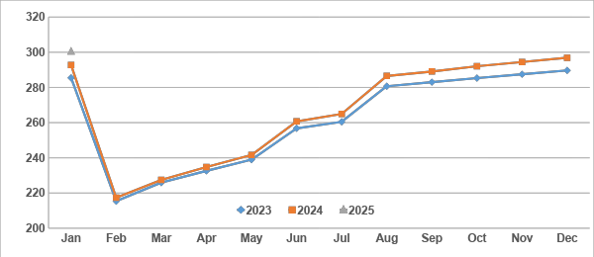
Total IEEE Higher Grade Membership
300,466 (+2.6% YoY)
Data as of 31 January 2025

Slide 22
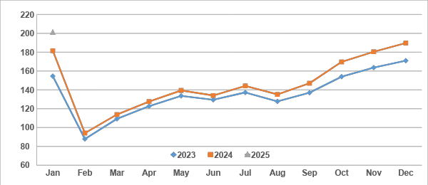
Total IEEE Student Membership
200,891 (+10.6% YoY)
Data as of 31 January 2025

Slide 23
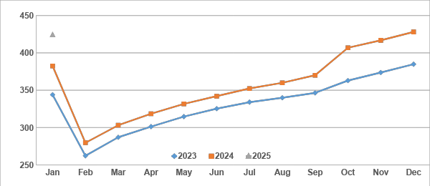
Total IEEE Society Memberships
424,065 (+10.9% YoY)
Data as of 31 January 2025

Slide 24
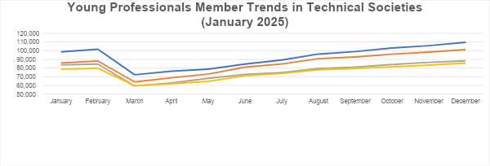
IEEE Young Professionals in Technical Activities
yp.ieee.org
As of January 2025:
Of 422,775 total Society Memberships
107,698 YP Memberships
Average of 25% YP Members
ranging from 9% to 42%

Slide 25
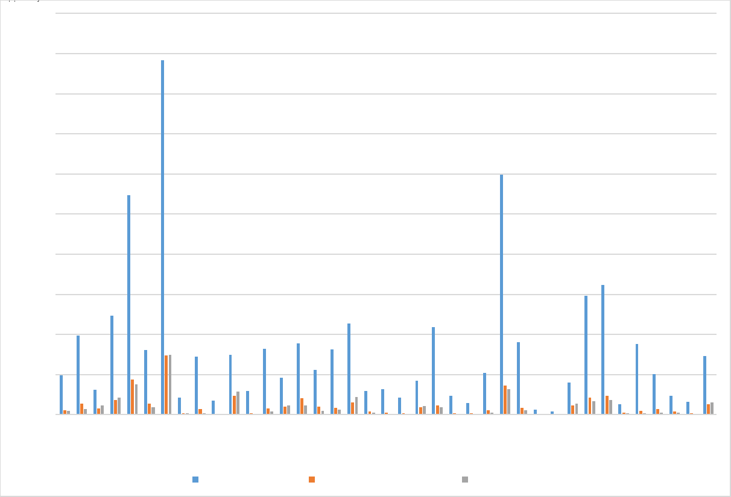
IEEE Women in Engineering in Technical Activities
wie.ieee.org
As of February 2025:
Of 313,965 Society Memberships
47,535 Female Memberships
41,782 WIE Memberships
Average of 13% WIE Members
ranging from 2% to 39%

Slide 26
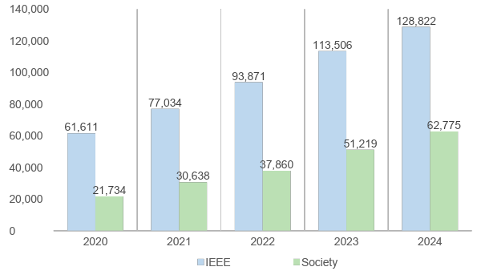
IEEE Students in Technical Activities
students.ieee.org
December year-end 2024:
128,822 Student Members
116,927 Student Society memberships
62,775 Student Members with at least (1) Society membership = 49%
IEEE vs. Society Student Members YoY Comparison 2020-2024 (December year-end)

Slide 27
IEEE Life Members in Technical Activities
life.ieee.org
As of January 2025 reporting month, # Life members belonging to at least (1) Society:
13,102 Life Members (of 21,187) = 62%
7,241 Life Seniors (of 12,930) = 56%
3,544 Life Fellows (of 6,816) = 52%
________________________________
23,887 overall (of 40,933) = 58%
Life members with Society Memberships by Region (January 2025)

Slide 28
Top 10 Countries: Total IEEE Membership
2024 Rank | Country | 2024 Membership | 2014 Membership | % Change Since 2014
1 | USA (R1-6) | 156,418 | 198,950 | -21.4%
2 | India | 94,541 | 48,169 | 96.3%
3 | China | 48,868 | 13,926 | 250.9%
4 | Japan | 14,643 | 14,218 | 3.0%
5 | Canada | 14,359 | 17,848 | -19.5%
6 | United Kingdom | 9,415 | 9,749 | -3.4%
7 | Germany | 9,078 | 8,111 | 11.9%
8 | Tunisia | 7,880 | 963 | 718.3%
9 | South Korea | 7,728 | 5,636 | 37.1%
10 | Australia | 7,529 | 8,157 | -7.7%
Data as of 31 December 2024

Slide 29
Top 10 Countries: Higher-Grade IEEE Membership
2024 Rank | Country | 2024 Membership | 2014 Membership | % Change Since 2014
1 | USA (R1-6) | 132,907 | 167,576 | -20.7%
2 | China | 27,449 | 9,671 | 183.8%
3 | India | 22,634 | 14,418 | 57.0%
4 | Japan | 12,152 | 12,431 | -2.2%
5 | Canada | 11,286 | 13,780 | -18.1%
6 | United Kingdom | 7,390 | 7,682 | -3.8%
7 | Germany | 6,301 | 6,132 | 2.8%
8 | Australia | 5,925 | 6,571 | -9.8%
9 | Italy | 4,983 | 3,820 | 30.4%
10 | South Korea | 4,052 | 3,279 | 23.6%
Data as of 31 December 2024

Slide 30
Top 10 Countries: Total Student Membership
2024 Rank | Country | 2024 Membership | 2014 Membership | % Change Since 2014
1 | India | 71,907 | 33,751 | 113.1%
2 | USA (R1-6) | 23,511 | 31,374 | -25.1%
3 | China | 21,419 | 4,255 | 403.4%
4 | Tunisia | 7,350 | 642 | 1044.9%
5 | South Korea | 3,676 | 2,357 | 56.0%
6 | Jordan | 3,165 | 755 | 319.2%
7 | Sri Lanka | 3,127 | 895 | 249.4%
8 | Mexico | 3,084 | 1,587 | 94.3%
9 | Canada | 3,073 | 4,068 | -24.5%
10 | Germany | 2,777 | 1,979 | 40.3%
Data as of 31 December 2024

