Slide 1
2026 GreenTech Conference and R5 Congress March 25-29, 2026
Welcome Back to Colorado!

Slide 2
Boulder
Limelight Boulder, CU Boulder Campus

Slide 3
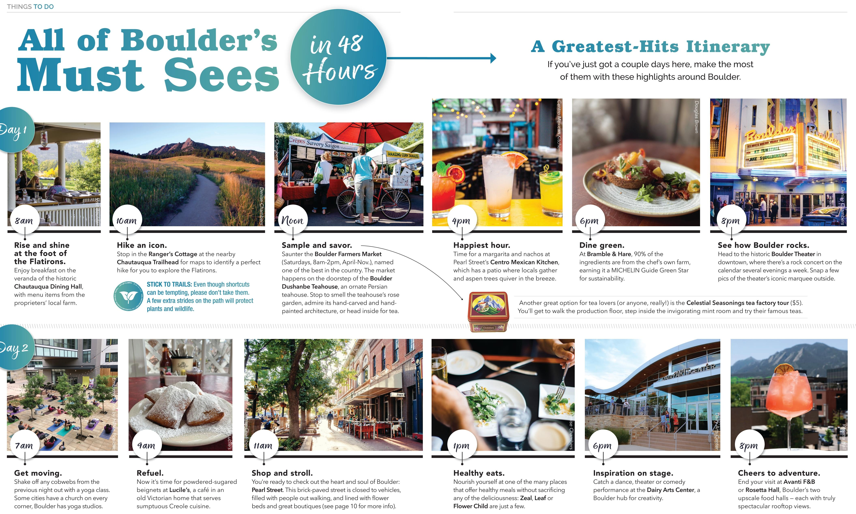

Slide 4
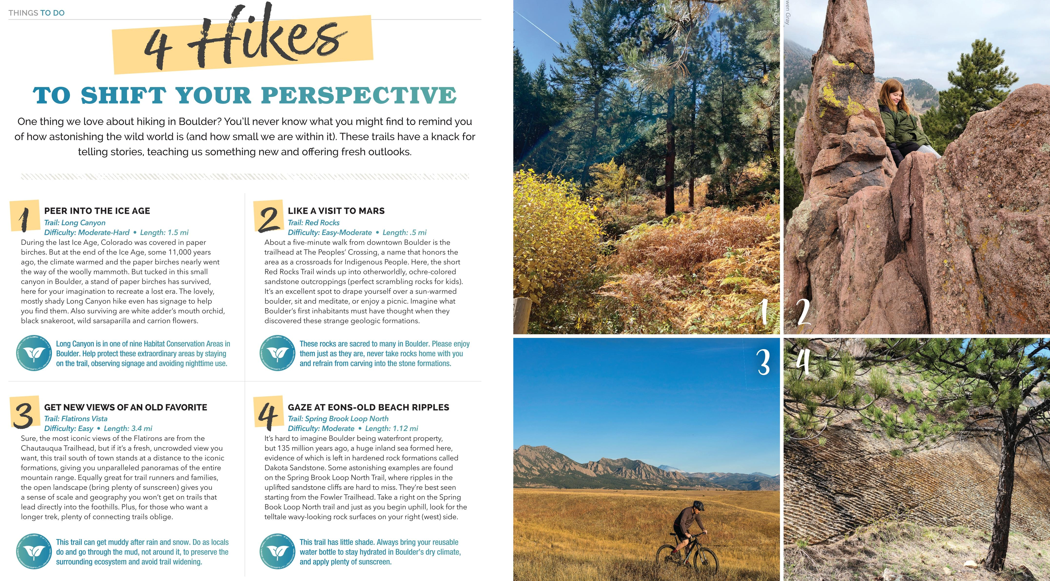

Slide 5
Aurora
Hyatt Regency Aurora-Denver Conference Center
Southlands Mall

Slide 6
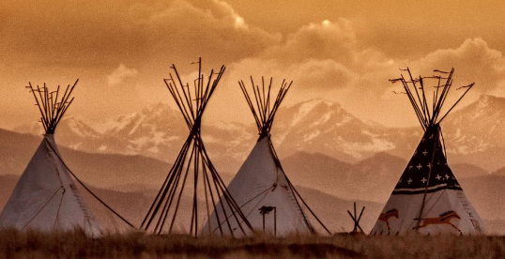
Aurora
Wings over the Rockies
Plains Conservation Center

