Slide 1
IEEE-USA & Region 5
Tim Lee, IEEE-USA President
Region 5 AGM Witchita, KS
29 March 2025

Slide 2
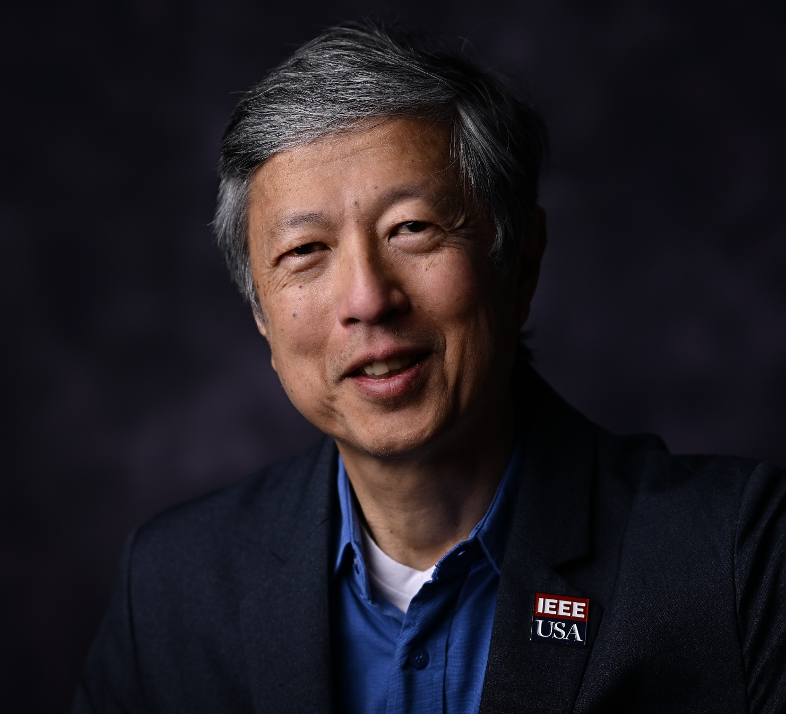
Timothy Lee, a Boeing Technical Fellow based in Southern CA, leads the development of disruptive microelectronics technologies for advanced communications networks and sensor systems for airborne and space applications. His current research interests include heterogenous integration (Advanced Packaging), silicon Application Specific Integrated Circuits (ASICs) and gallium nitride Monolithic Microwave Integrated Circuits (MMICs). He led the development of hardware for satellite communications and has built phased-array antenna electronics for commercial and US government customers. He is an active volunteer in the IEEE. He is the 2025 IEEE-USA President; seeking collaboration on technology policy for R&D, STEM education and Workforce Development. Previous roles includes IEEE Board of Directors (2021-2022 Region 6) and past President of the IEEE Microwave Theory and Technology Society (MTT-S). He leads several Technical Working Groups in the IEEE Heterogenous Integration Roadmap (HIR) and is the Vice-Chair in the IEEE Future Networks Technical Community.
Timothy Lee
IEEE-USA President

Slide 3
IEEE-USA - Supporting the career and public policy interests of IEEE US Members
Mission
IEEE-USA’s mission is to recommend policies and implement programs specifically intended to serve and benefit the members, the profession and the public in the United States in appropriate professional areas of economic, ethical, legislative, social and technology policy concern.
Vision
Our vision is to serve the U.S. IEEE member by being the technical professional’s best resource for achieving lifelong career vitality and by providing an effective voice on policies that promote U.S. prosperity.
#OneIEEE
https://ieeeusa.org/

Slide 4
2025 Policy Priorities
Promotion of Science & Technology
Federal R&D Funding & Programming
CHIPS Act Funding & Programs
AI Regulations
Immigration
Energy
Space

Slide 5
IEEE-USA Congressional Visit Day
When/Where: 8-9 April 2025 | Washington, D.C.
IEEE-USA Congressional Visits Day (CVD) is an annual event that brings engineers, scientists, mathematicians, researchers, educators, and technology executives to Washington to raise visibility of and support for engineering and technology. This premier event is open to all IEEE members in the United States.
CVD’s Objectives
CVD is an opportunity to introduce yourself, your colleagues, your company, and your profession to our elected officials. It also a great opportunity to discuss legislation and issues that are uniquely important to IEEE members.

Slide 6
TRENDING ON IEEE-USA InSight
IEEE-USA Career and Members Services
Hard Skills Impress; Soft Skills Persuade
Unleashing Your Potential Through Microlearning
Embrace Change and Thrive in the Next Quarter-Century
Reset, Reflect, Repeat: Leaning into Discomfort
Six Things To Know About Your Boss
Eight Key Skills Needed to Effectively Manage People
insight.ieeeusa.org

Slide 7
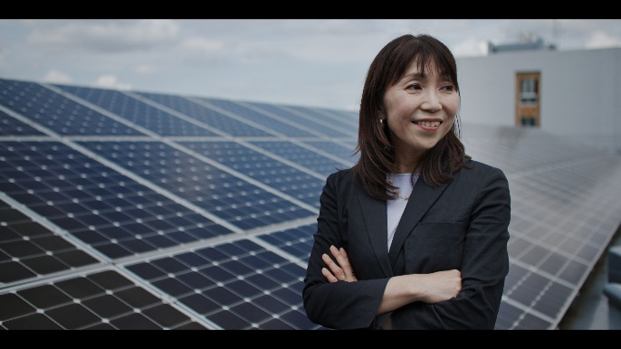
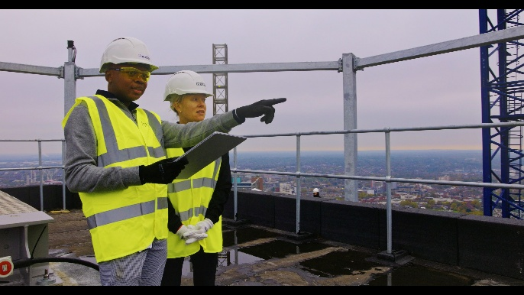
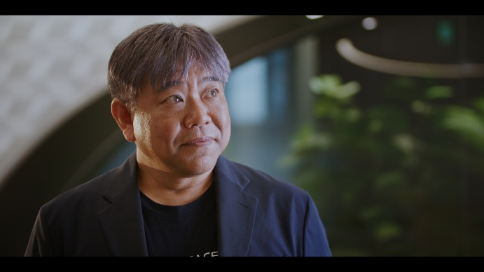
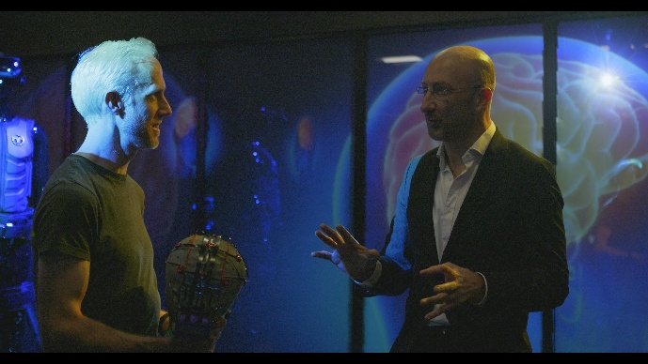
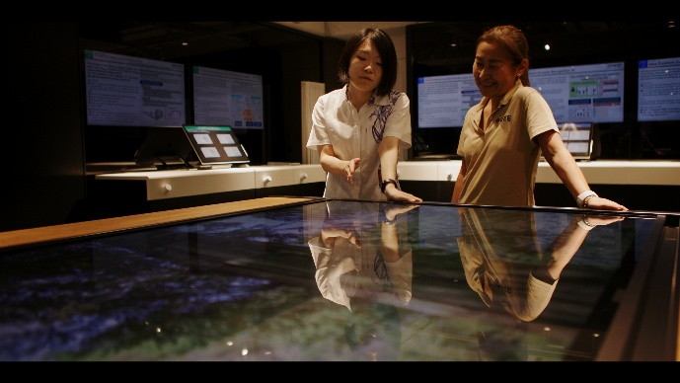
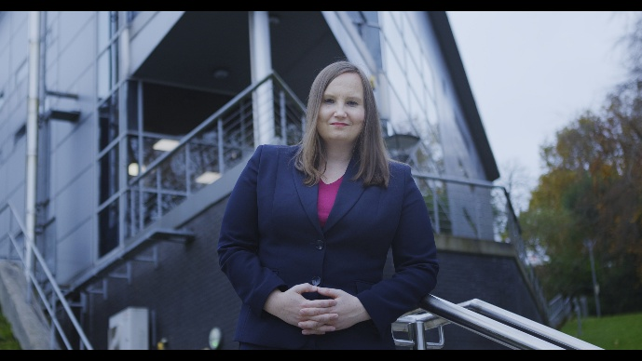
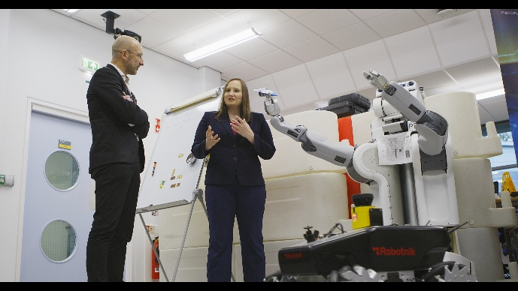
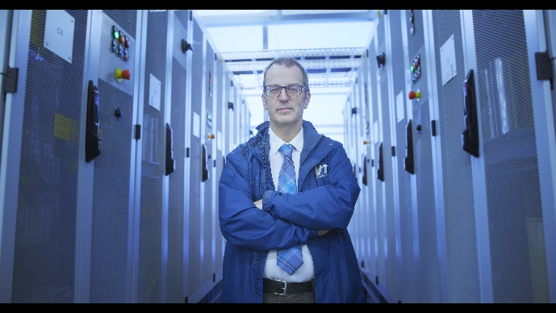
IEEE PROFESSIONAL HOME CAMPAIGN
IEEE-USA Communications
At IEEE President Tom Coughlin’s request, we took on producing/directing a video project to raise the visibility of IEEE members all over the globe. This “IEEE is my Professional Home” campaign is a continuation of something we started in late 2019 called “IEEE-USA is my Competitive Edge” – and has been highly successful.
We filmed members in Tokyo, Japan; Glasgow, Scotland; London, England & Belfast, Northern Ireland.
Work is now complete on the 7 video spots
NIC approved additional funding of $150k late last year to help promote the videos in 2025. 50k for Japan, 50k for the UK and 50k for US marketing purposes via streaming, cable and over the air TV.
Spots will begin airing on those markets in the months ahead, along with organic social media, YouTube and more.

Slide 8
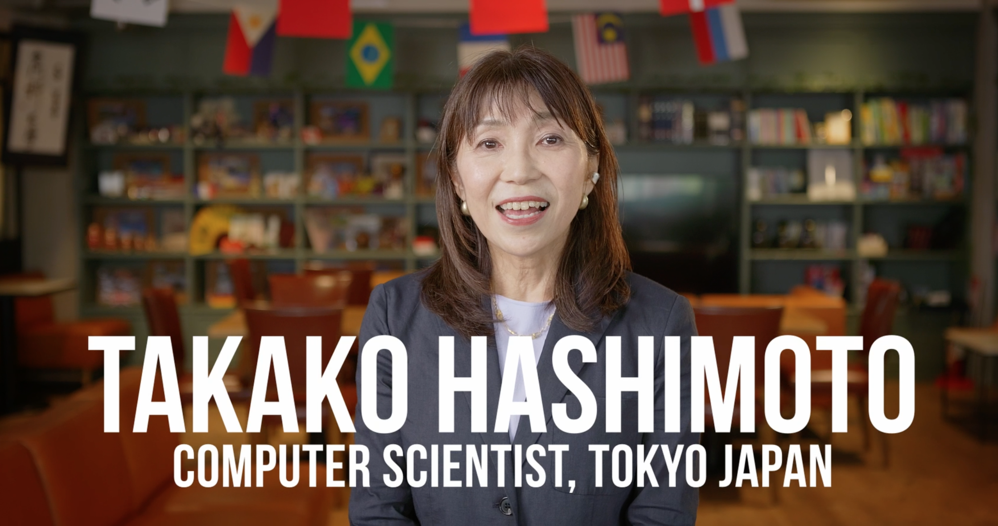

Slide 9
Industry Engagement Critical to Membership in USA

Slide 10
IEEE Membership – Overall and Industry, 2000 to 2024
IEEE and IEEE-USA’s goal to invigorate growth of Industry Membership and Participation
Notes:
Has been a steady decline in Industry members over the past 20 years, but we did have a modest increase in 2024\ – but see two slides later -- on Corporate MSD sales

Slide 11
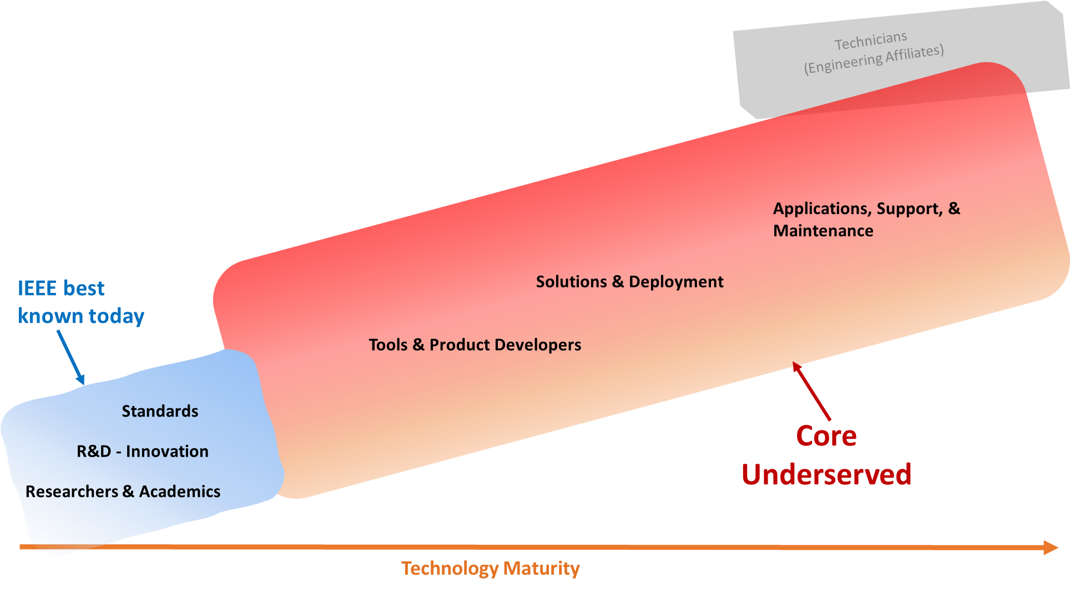
Industry Professionals’ Needs Across Verticals
Building Tech Communities
Tech Corridors
Rural Areas
Tech Policy Across Sectors
Career Development
STEM Pipeline
Transportation
HealthCare
Communications
Semiconductors
Advanced Computing
How can we work together in 2025 to make a difference?
AGI
AI Policy
5G/6G
Comm Policy
Autonomy
Energy Policy
IoT
IC & Packaging
CHIPS, R&D
Industry Engagement need to focus on Verticals
Notes:
The biggest group of industry members are those most closely aligned with academia, that is, those in Research or R&D. We’re largely missing those industry technology professionals who make up the bulk of those in our fields, particularly those in solutions & deployment and those in applications, support, & maintenance.
While we don’t have precise numbers for those in the field for each of these categories (because they were developed by IEC),
Note: the recent All-societies Research Project* has data on this question specifically, which shows that. For that question, looking at the members in industry who responded to the survey, more than half were in either R&D (47%) or Research and Academics (6%). The rest were relatively evenly spread across the other categories.
The question in the member database on whether they spend 50% or more of their time on Research also suggests that a high percentage of our members are in these first two categories – with close to 40% saying they spend 50% or more of their time on Research.
* The All Societies Research Project is a survey that has been done every four years the past 12 years and includes samples from every society.

Slide 12
Support to Global Semiconductors Kathy Hayashi Tim Lee Matt Francis

Slide 13
CHIPS and Science Act of 2022
The CHIPS Act is a bill that provides $52.7 billion for American semiconductor production, research and development, and workforce education initiatives123. It aims to encourage companies to move chip manufacturing back into the United States and strengthen the country's ability to compete in future technologies.
The Act also includes funding for technology deployment and workforce development
IEEE-USA funded Fellow contributed to sections of the CHIPS and Science Act
Advanced Packaging is the new paradigm for next generation microelectronics advancements
Building Infrastructure and Workforce Development
https://ieeeusa.org/ieee-usa-commends-chips-act/

Slide 14
Source: DoD Office of Undersecretary of Defense for Acquisition and Sustainment, April 2021

Slide 15
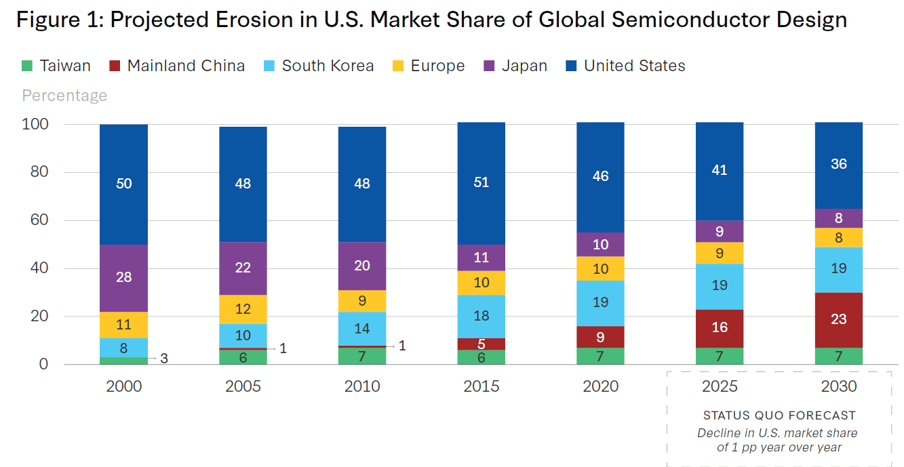
Chip Design and National Security
The stakes are genuinely important. U.S. semiconductor design leadership means that U.S.-designed chips are superior to those from all other countries in terms of performance, sophistication, energy efficiency, and security—representing enormous strategic leverage.
Moreover, because these chips are incorporated into virtually all U.S. defense platforms, the quality and reliability of the chips embedded in U.S. systems play a key role in battlefield performance, information acquisition, and evaluation
The Need for a Long-Term, Well-Financed Effort on Talent
Policies Needed:
Increase Investment that Support Design R&D
Promote Domestic Talent
Grow the Talent Pool
Recognize the Value of Trade
Expand Tax Incentives
https://www.csis.org/analysis/growing-challenges-semiconductor-design-industry-united-states-cannot-take-leadership
DISTRIBUTION STATEMENT A. Approved for public release: distribution unlimited.

Slide 16
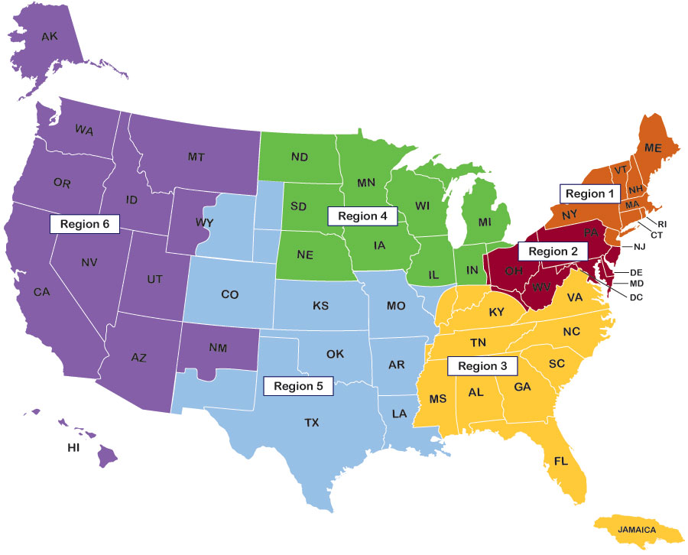
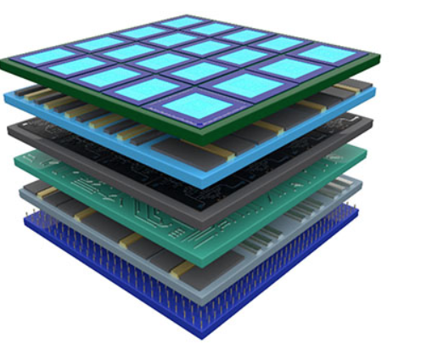
USG Funded R&D - Opportunities are Plentiful to engage Students, Young Professionals and Industry
IWRC Dakotas
NSTC EUV R&D – Albany, NY
NSTC HQ – Sunnyvale, CA
NordTech
NW AI Hub
NEMC Hub
Phoenix, AZ
SCMC Hub
MMEC Hub
CA DREAM Hub
SWAPHub
IWRC Little Rock, AK
CLAWS Hub
DARPA NGMM
IWRC Alabama
NGMM – UTA
The Future
San Diego, CA
https://chips.ieeeusa.org/
https://iwrc.ieeeusa.org/
https://microelectronicscommons.org/
https://chips.gov

Slide 17
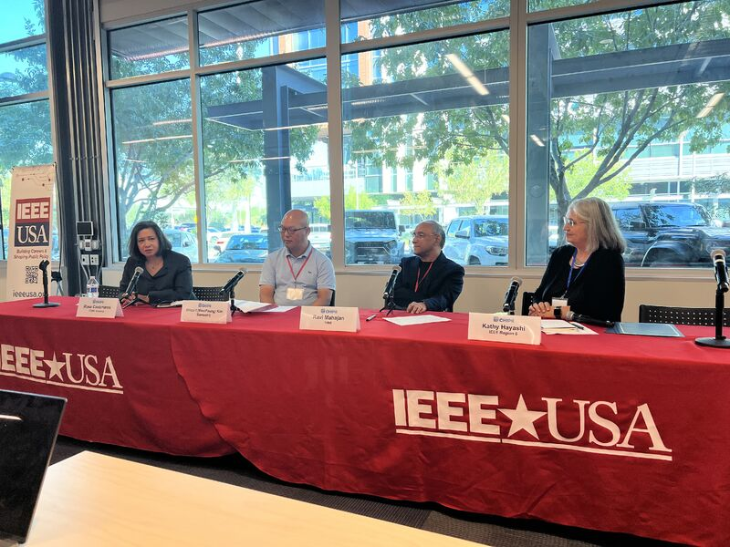
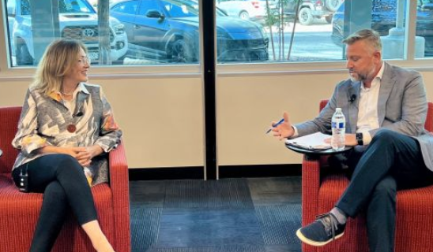
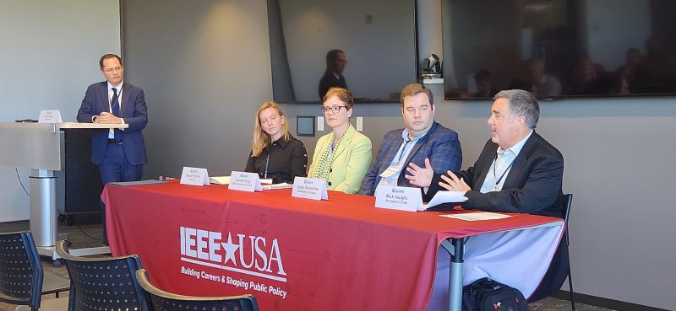
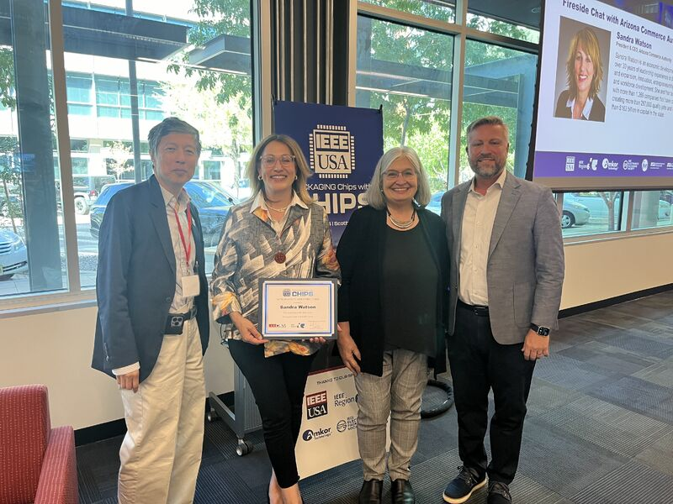
Community Discussions – Industry/Academia/Gov and more
Shared Stakeholders for Technology Advancement for Humanity:
Industry + Academia + Government
Sandra Watson, President and CEO
Arizona Commerce Authority and
Erik Heilman, Director of Government Relations, IEEE-USA

Slide 18
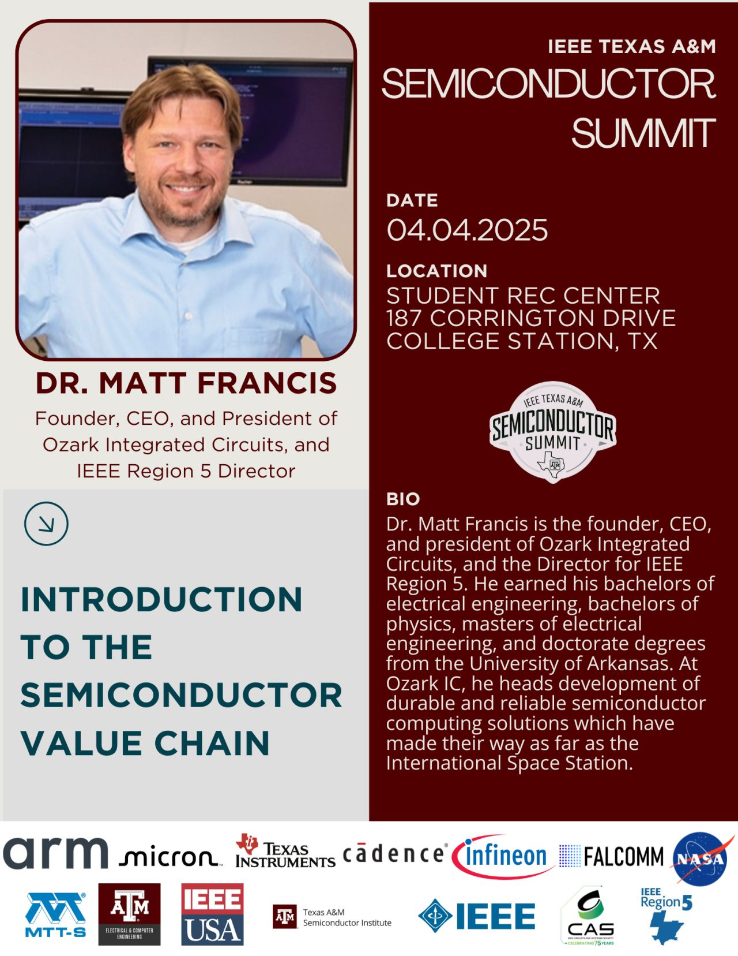
The IEEE Texas A&M University 𝗦𝗲𝗺𝗶𝗰𝗼𝗻𝗱𝘂𝗰𝘁𝗼𝗿 𝗦𝘂𝗺𝗺𝗶𝘁 — the 𝗳𝗶𝗿𝘀𝘁-𝗲𝘃𝗲𝗿 𝘀𝘁𝘂𝗱𝗲𝗻𝘁-𝗹𝗲𝗱 𝘀𝗲𝗺𝗶𝗰𝗼𝗻𝗱𝘂𝗰𝘁𝗼𝗿 𝗰𝗼𝗻𝗳𝗲𝗿𝗲𝗻𝗰𝗲 𝗶𝗻 𝘁𝗵𝗲 𝗨𝗦𝗔! – 04 April 2025
This student-led conference connects Texas A&M engineers with semiconductor industry leaders through keynote talks, hands-on workshops, and networking opportunities, empowering students to join the next generation of innovators shaping America’s chip workforce.
Thank you, TAMU organizers!
Akshat Nerella, IEEE TAMU President
Sharon Thomas, Conference Director
Fidel Makatia, Conference Director
IEEE-USA is proud to be a Sponsor!
https://conference.ieee-tamu.org/agenda

Slide 19
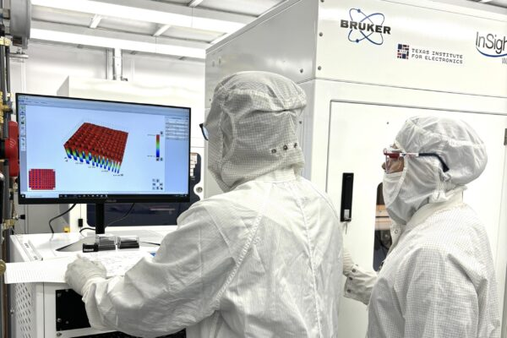
Advanced Packaging R&D Funded by the DoD - NGMM
Microelectronics Manufacturing program (NGMM) to establish national center for advancing U.S.-based 3D heterogeneous integration (3DHI).
Why 3DHI: Development of 3DHI technologies creates the ability to stack separately manufactured components – chips or wafers originating in different facilities, containing different semiconductors and materials – within a single package.
In realizing 3DHI microelectronics that incorporate diverse materials beyond silicon, NGMM focuses on revolutionary improvements in functionality and performance.
UT Austin (Texas Institute for Electronics) awarded $840M for NGMM
Phased Array
Imager
Others
https://www.darpa.mil/research/programs/next-generation-microelectronics
Early planning for IEEE-USA Event in Austin in the Fall!
https://news.utexas.edu/2024/07/18/uts-texas-institute-for-electronics-awarded-840m-to-build-a-dod-microelectronics-manufacturing-center-advance-u-s-semiconductor-industry/
https://www.darpa.mil/research/programs/next-generation-microelectronics

Slide 20
Academia + Industry + Government = winning formula for Collaboration for Workforce Development

Slide 21
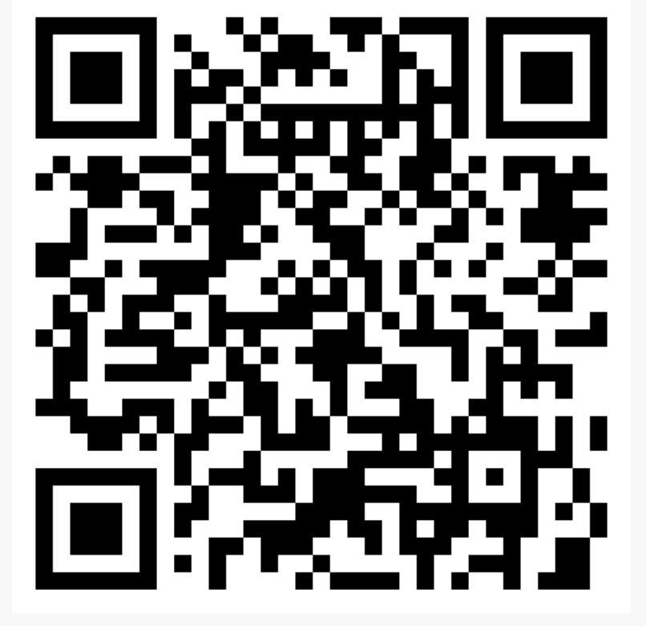
Connect with IEEE-USA
Connect with us
https://ieeeusa.org/
Subscribe to our newsletters
Tell us what new ideas we should consider
Lets work together for common goals!
Connect with me on Linkedin!

