Slide 1
Government Relations: National to Local March 29, 2025
Walter D. Downing, PE
IEEE Life Senior Member, Lone Star Section Chair
IEEE R5 Government Relations

Slide 2
Why Government Relations?
“We engineers are part of a larger society. In a shrinking and ever more independent world, and with diminishing resources, the engineer has a critical role to play. Increasingly, technology, research, innovation and productivity are becoming public-policy issues in the United States and throughout the world. We have an unquestionable responsibility to participate in the debate.”
Leo Young, 1980 IEEE President (1926-2006)

Slide 3
Building Careers & Shaping Public Policy
About IEEE-USA: IEEE organizational unit created in 1973 to support the career and public policy interests of IEEE's U.S. members. IEEE-USA is primarily supported by an annual assessment paid by U.S. IEEE members.
Mission: recommend policies and implement programs specifically intended to serve and benefit the members, the profession and the public in the United States in appropriate professional areas of economic, ethical, legislative, social and technology policy concern.
Vision: serve the U.S. IEEE member by being the technical professional’s best resource for achieving lifelong career vitality and by providing an effective voice on policies that promote U.S. prosperity.

Slide 4
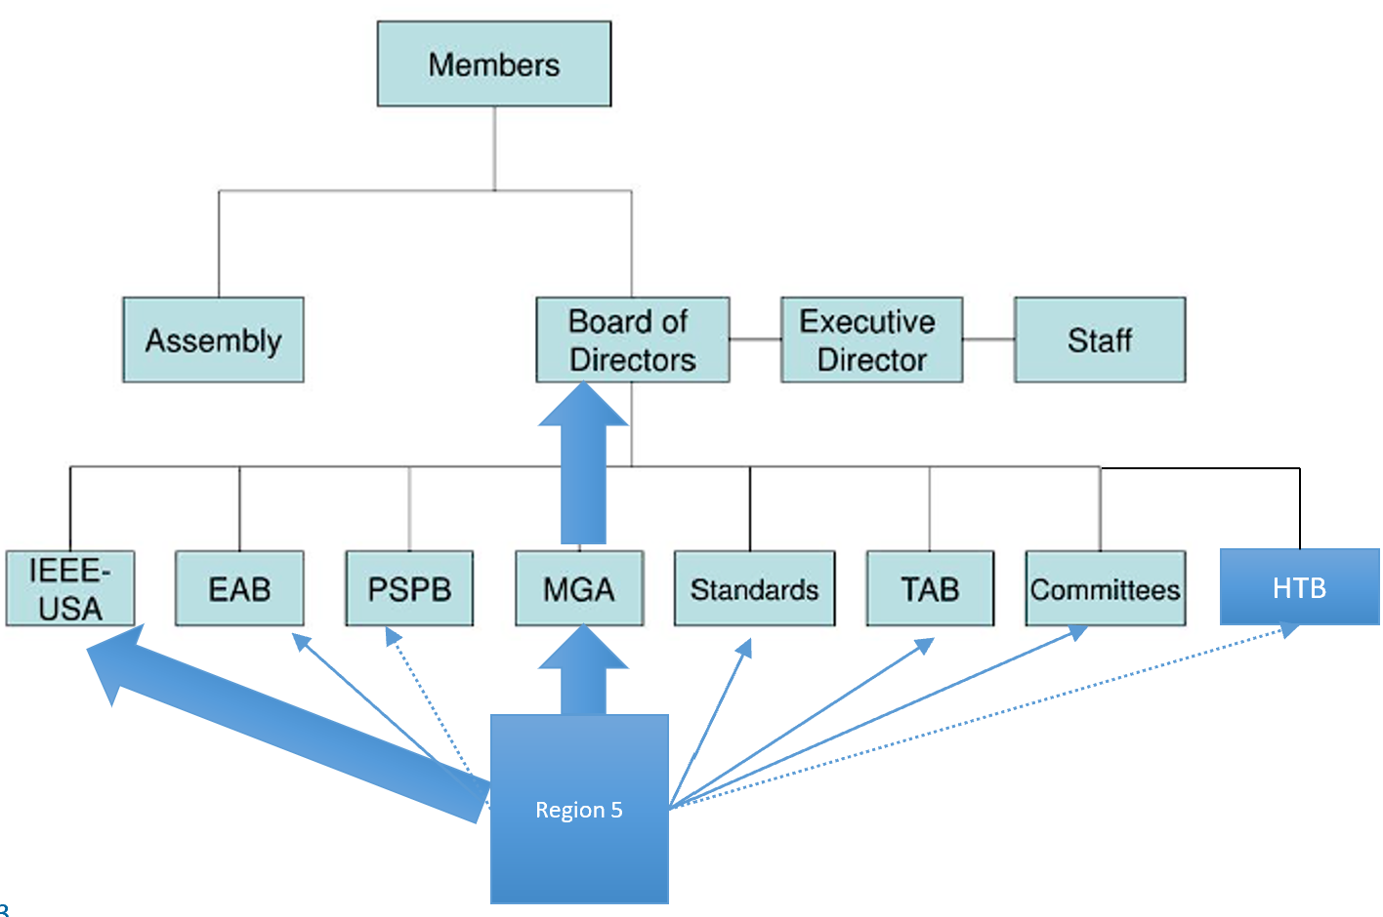
Building Careers & Shaping Public Policy

Slide 5
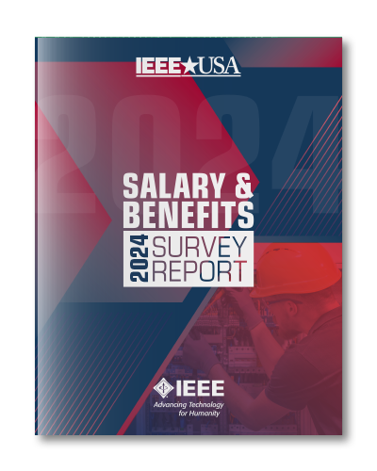
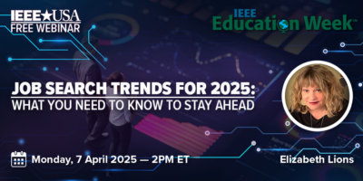
Library of <150 eBooks and audio books on career and professional development
Career and Professional Development webinars (earn PDH credits)
Salary & Benefits Service
Resources for Consultants
IEEE-USA online newsletters
InSight (monthly)
Conference Brief (quarterly)
Leadership Connection (monthly – YPs and Students only)
Special Events
Awards and Recognition

Slide 6
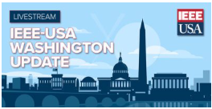
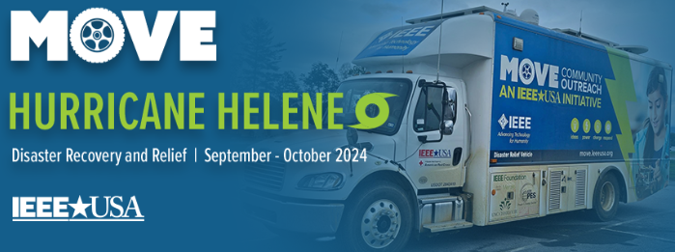
Public Policy Committees
Government Fellowships
WISE Internships
Weekly online SmartBrief newsletter
Public Policy Events
Policy Webinars
Congressional Visits Day (CVD)
Congressional Outreach Program (ICOP)
Other Public Engagement
MOVE Community Outreach
K-12 STEM Education Programs

Slide 7
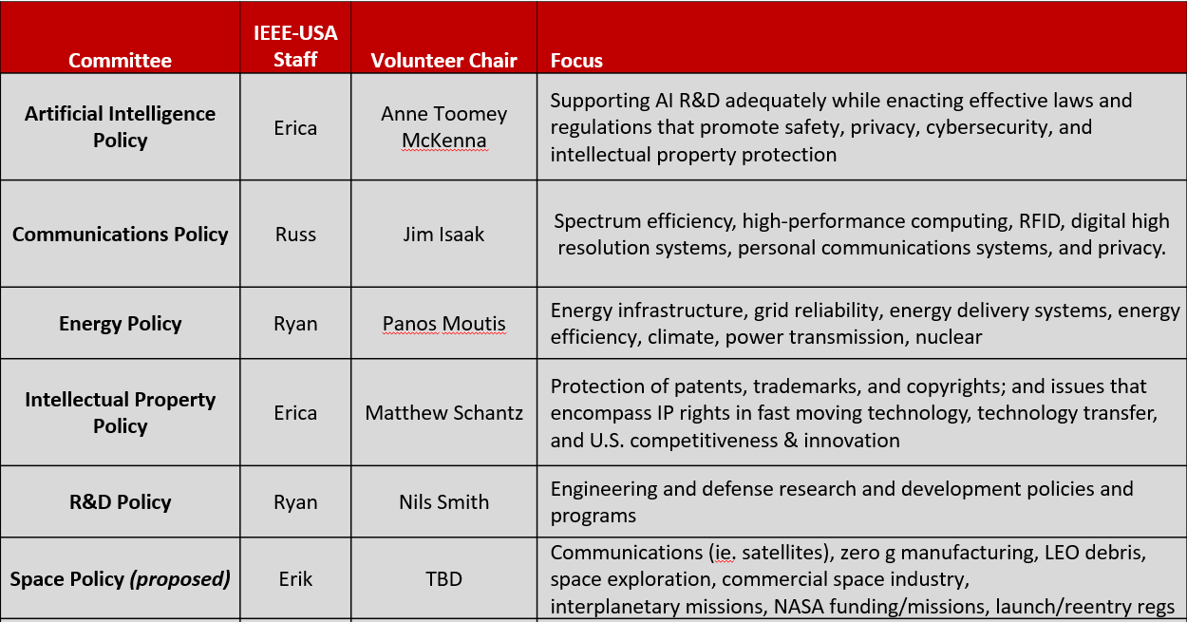
Public Policy Committees

Slide 8
2025 Policy Priorities (https://ieeeusa.org/public-policy/priorities/)
Promotion of Science and Technology
Federal R&D Funding and Programming
CHIPS Act Funding and Programs
AI Regulations
Immigration
Energy
Space

Slide 9
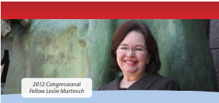
Congressional Fellowships
Created in 1973
Since inception, more than 100 IEEE U.S. members have worked on Capitol Hill as advisors to the U.S. Congress, serving on the personal staff of a Senator or Representative, or the professional staff of a congressional committee, of the fellow’s choosing.
Each year, eligible IEEE members are selected to serve a one-year fellowship by the IEEE-USA Government Fellows Committee.
Selections are based on applications and interviews.
Fellowships run from 1 September – 31 August each year.
Deadline for 2026-2027 Fellowship applications is Monday, 8 December 2025

Slide 10
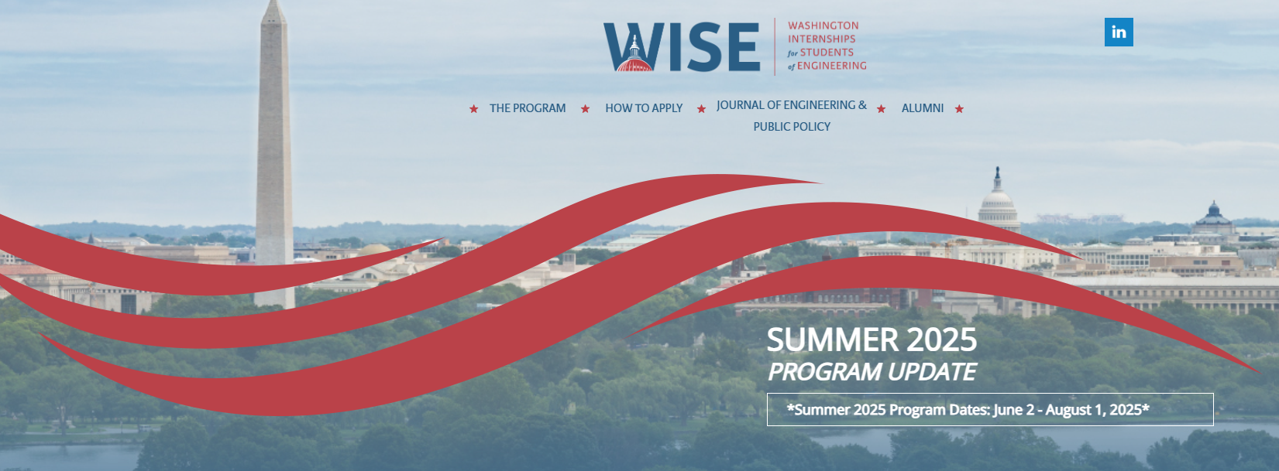
Washington Internships for Students of Engineering (WISE) – Applications for 2025 close on Monday, 31 March 2025
Founded in 1980 through the collaborative efforts of several professional engineering societies, the Washington Internships for Students of Engineering (WISE) program has become one of the premier Washington internship programs. WISE prepares future leaders of the engineering profession who are aware of, and who can contribute to, the increasingly important issues at the intersection of science, technology, and public policy in the United States.
Each summer, the WISE societies select outstanding 3rd or 4th year engineering/ computer science students, or students in engineering/ computer science graduate programs, from a nation-wide pool of applicants. The students spend nine (9) weeks living in Washington, D.C., during which they learn how government officials make decisions on complex technological issues, and how engineers can contribute to the legislative process and regulatory public policy decision-making.

Slide 11
Congressional Visits Day (CVD) – April 8-9, 2025 Registration is closed (400 registrants, 42 States, 320 first time)
IEEE-USA Congressional Visits Day (CVD) is an annual event that brings engineers, scientists, mathematicians, researchers, educators, and technology executives to Washington to raise visibility of and support for engineering and technology.
CVD is an opportunity to introduce yourself, your colleagues, your company, and your profession to our elected officials. It also a great opportunity to discuss legislation and issues that are uniquely important to IEEE members.
This premier event is open to all IEEE members in the United States.

Slide 12
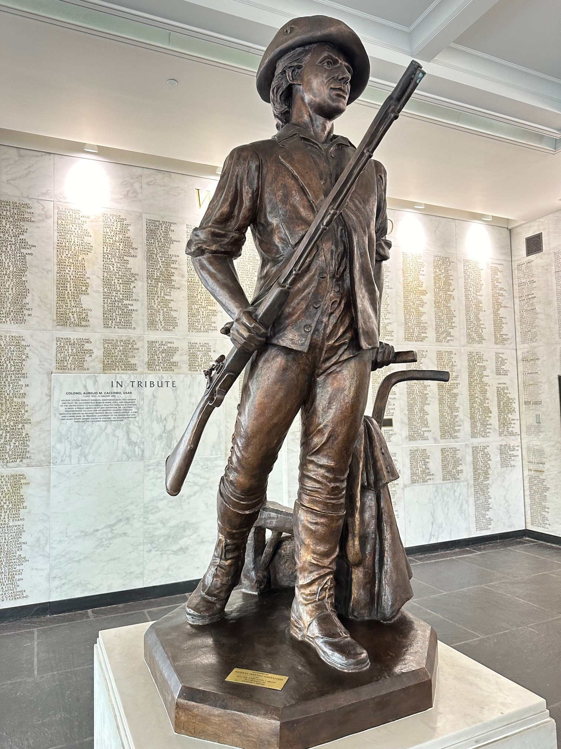
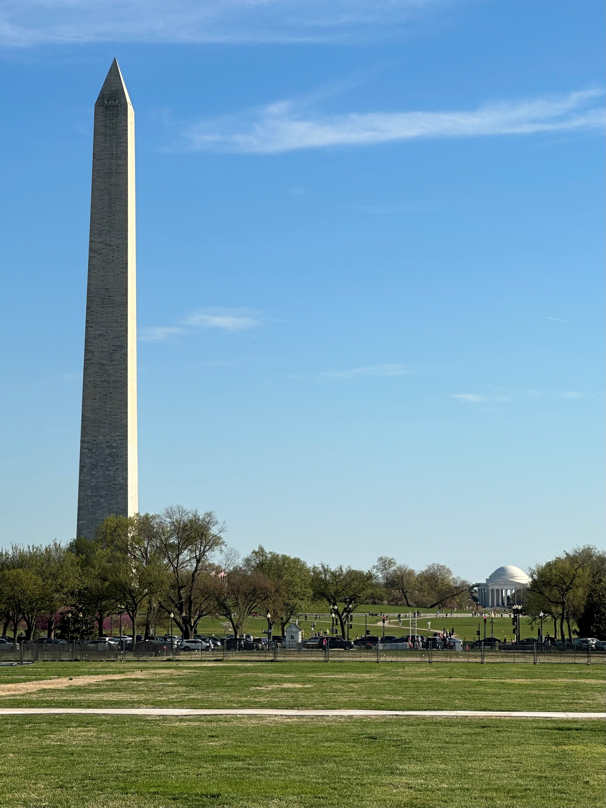
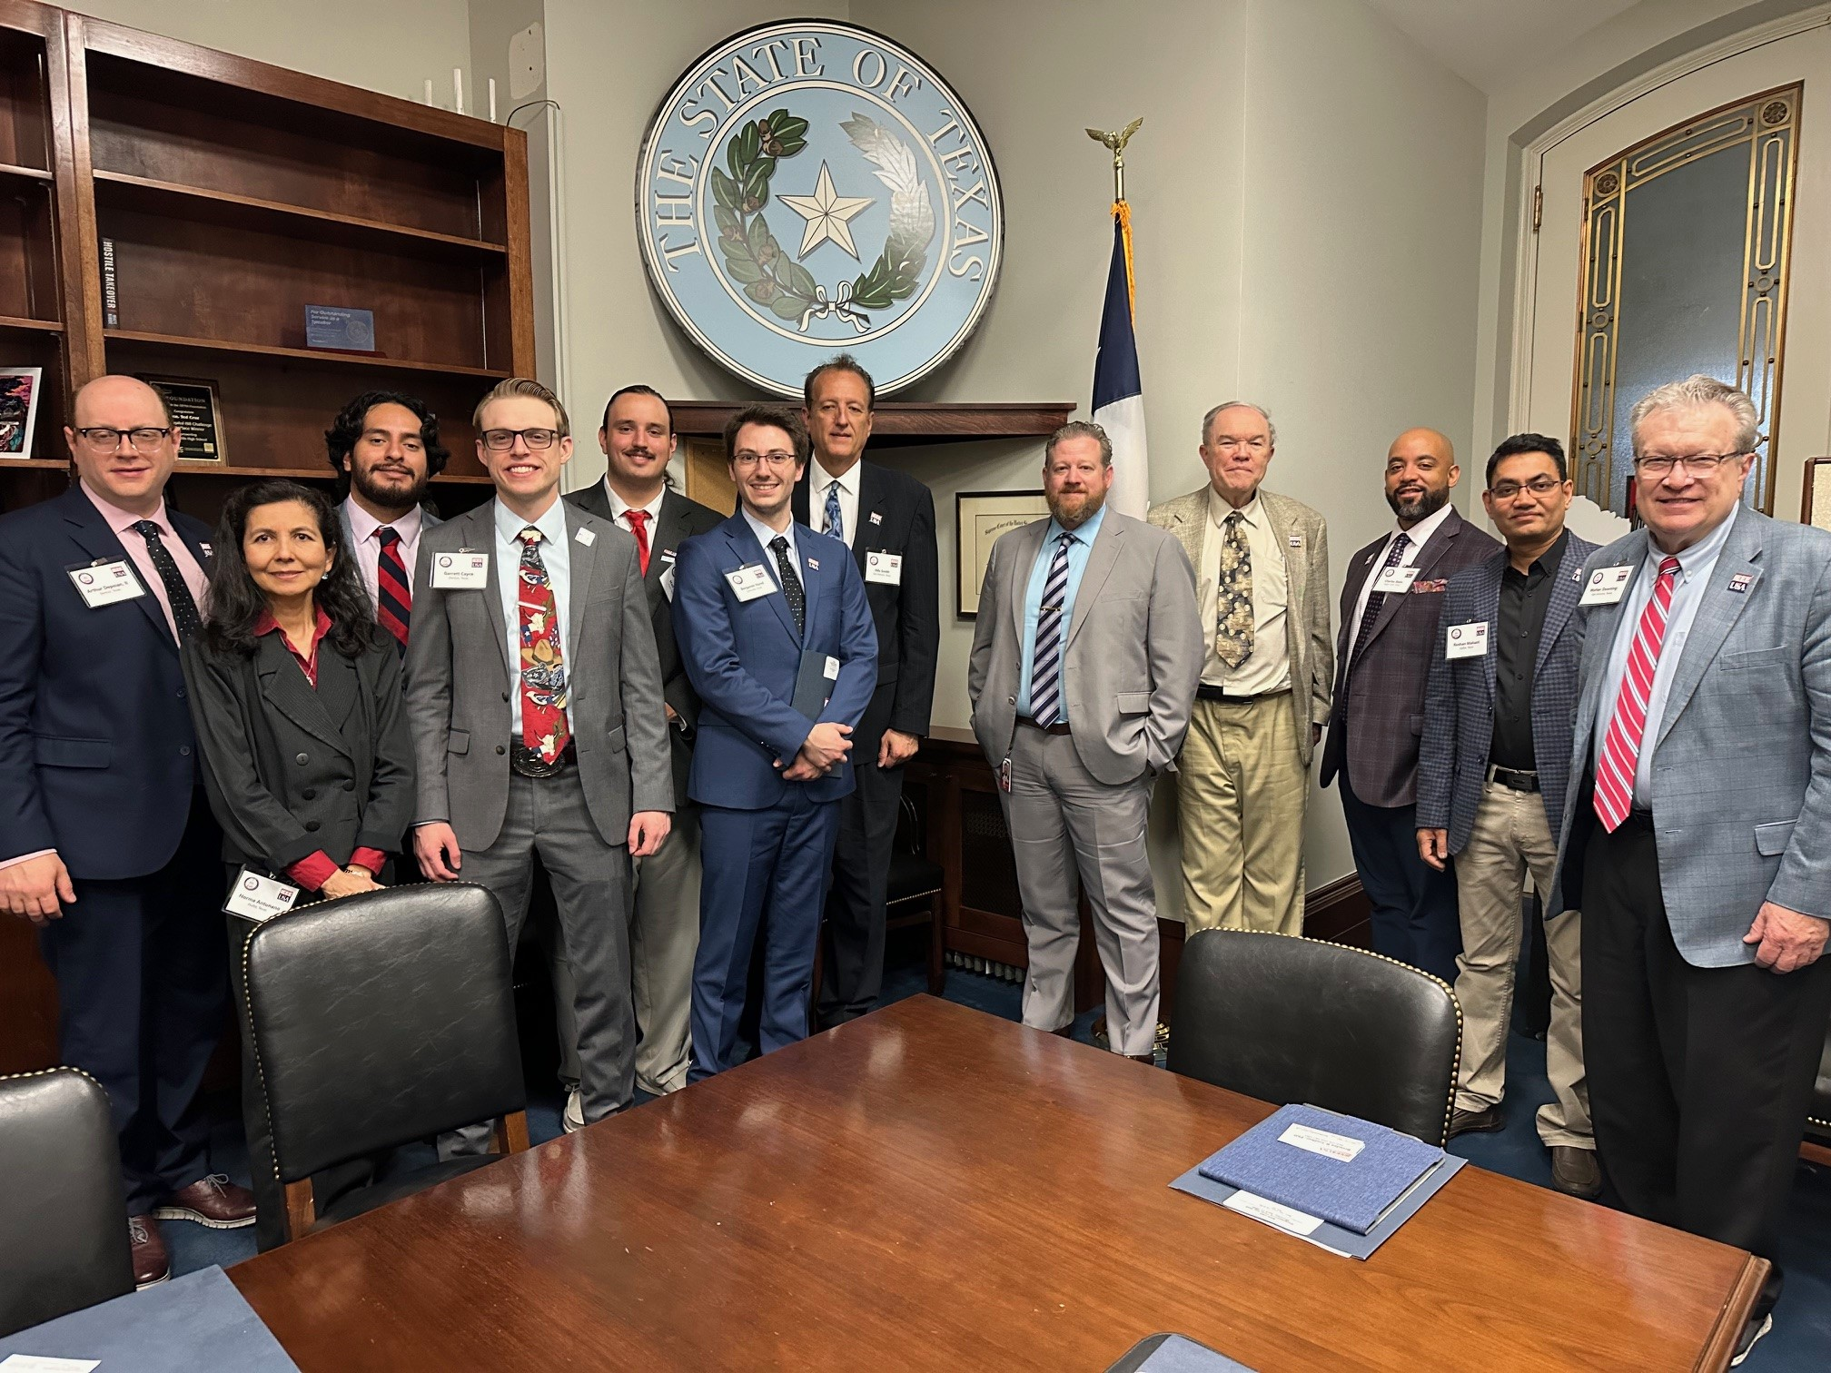
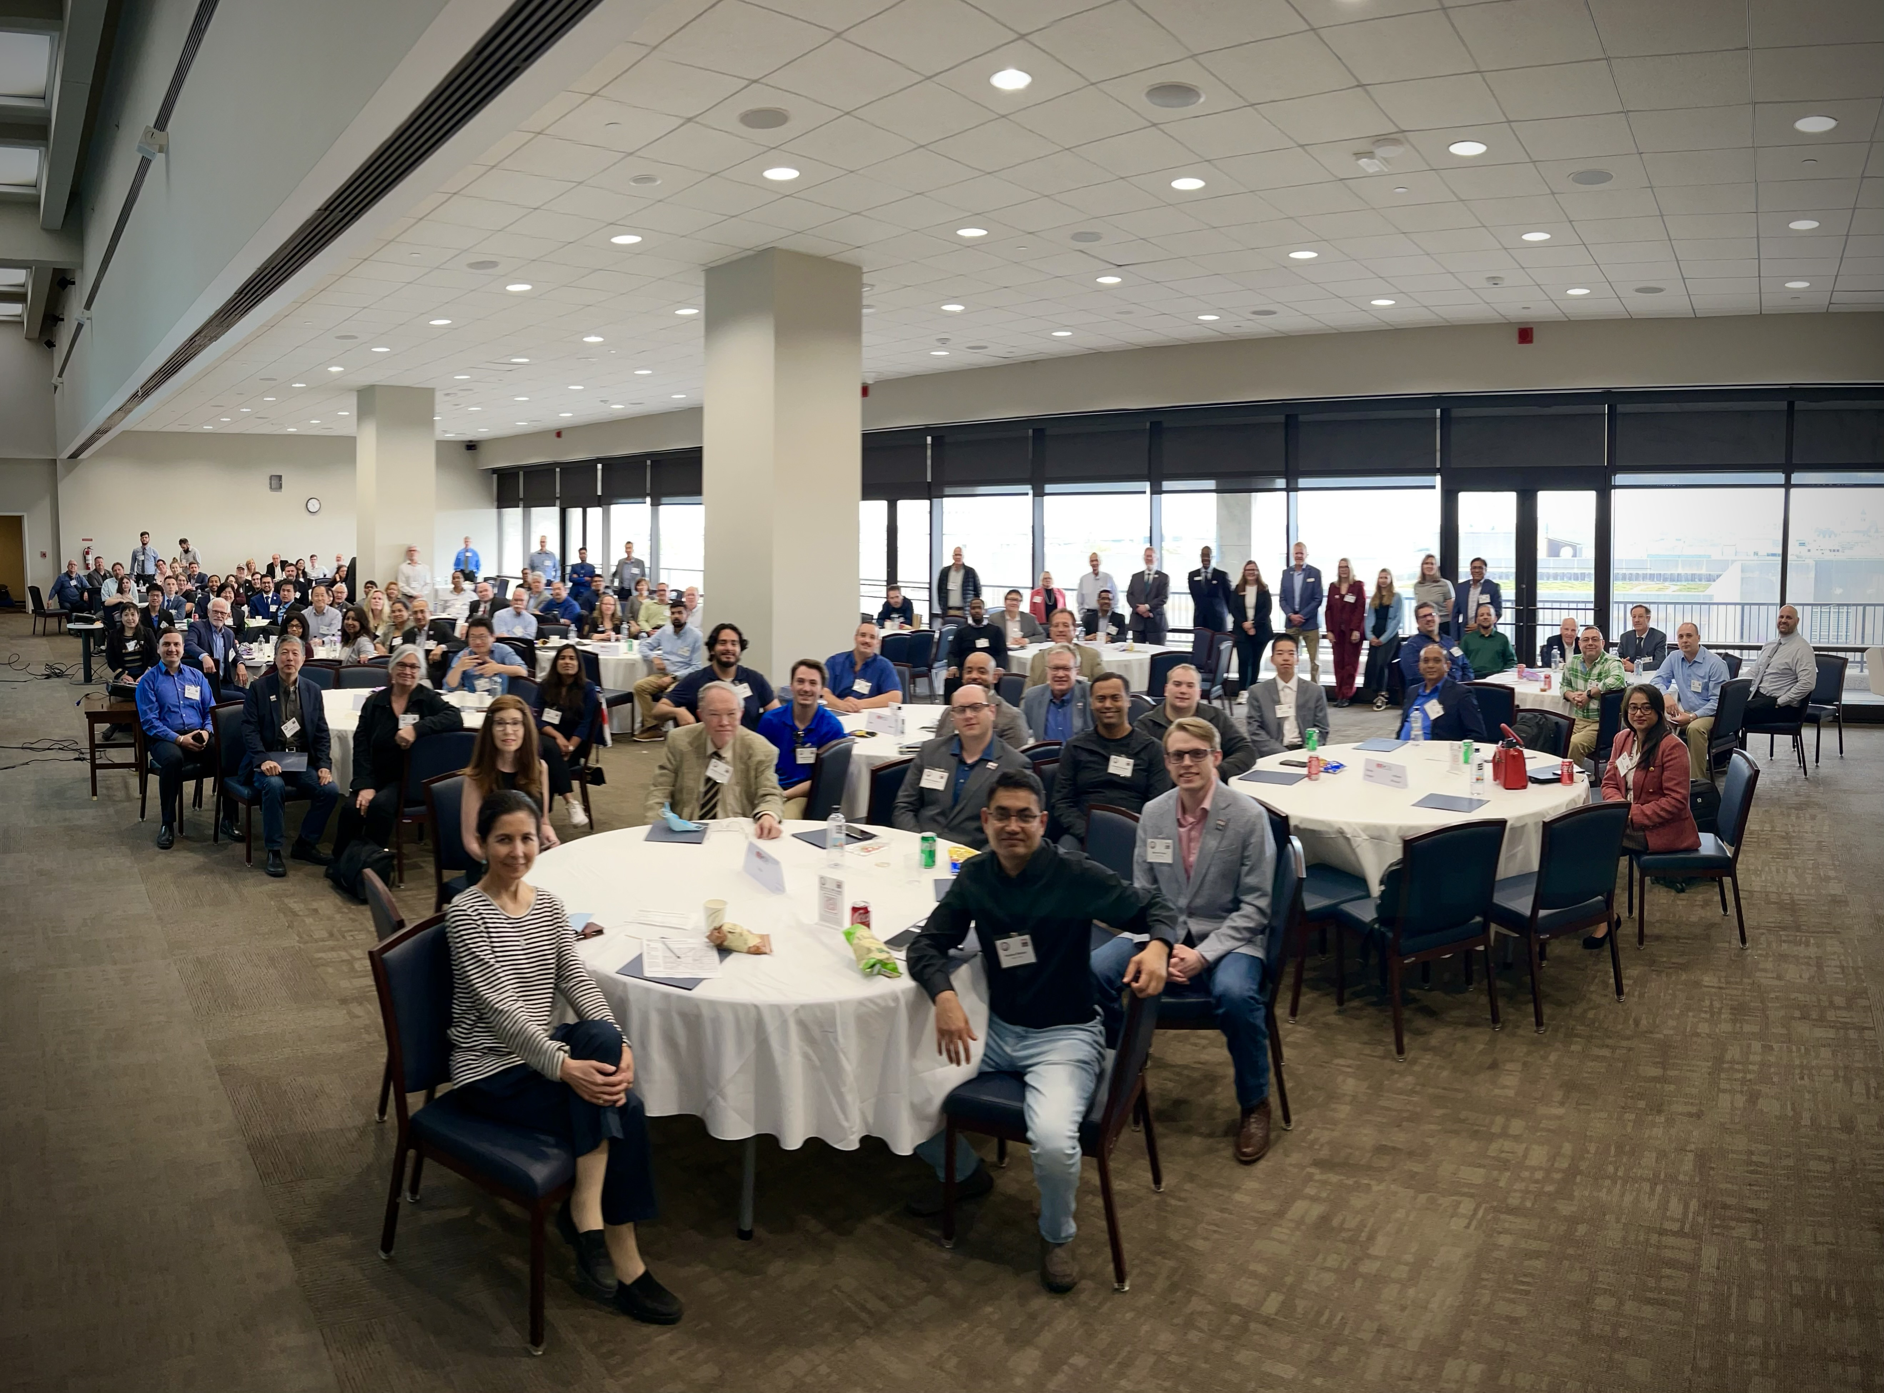
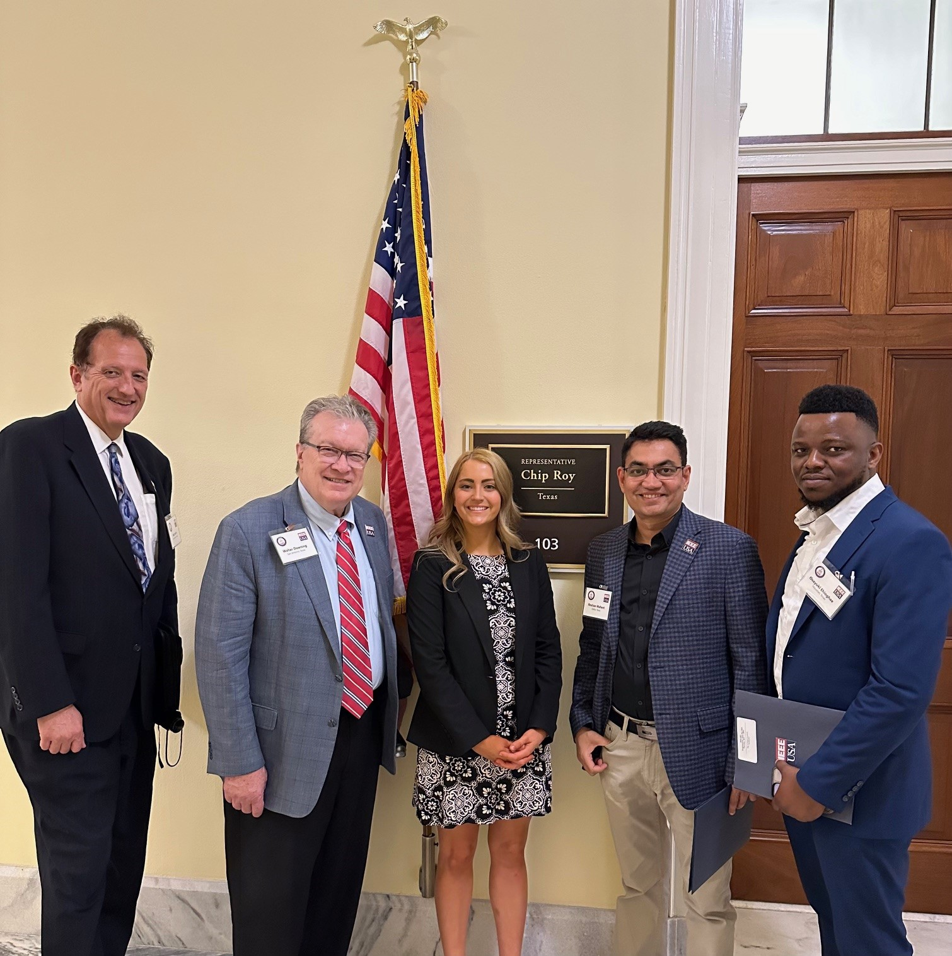
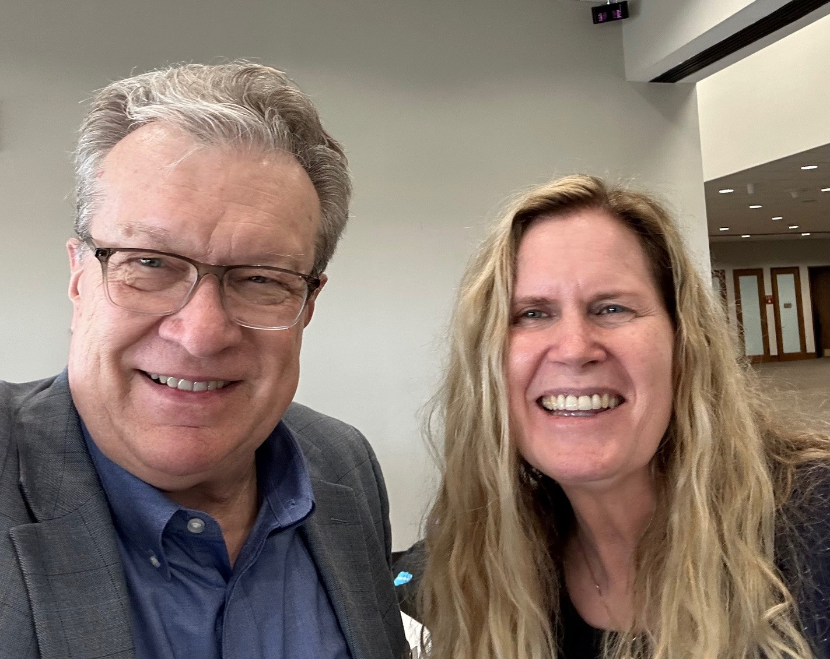
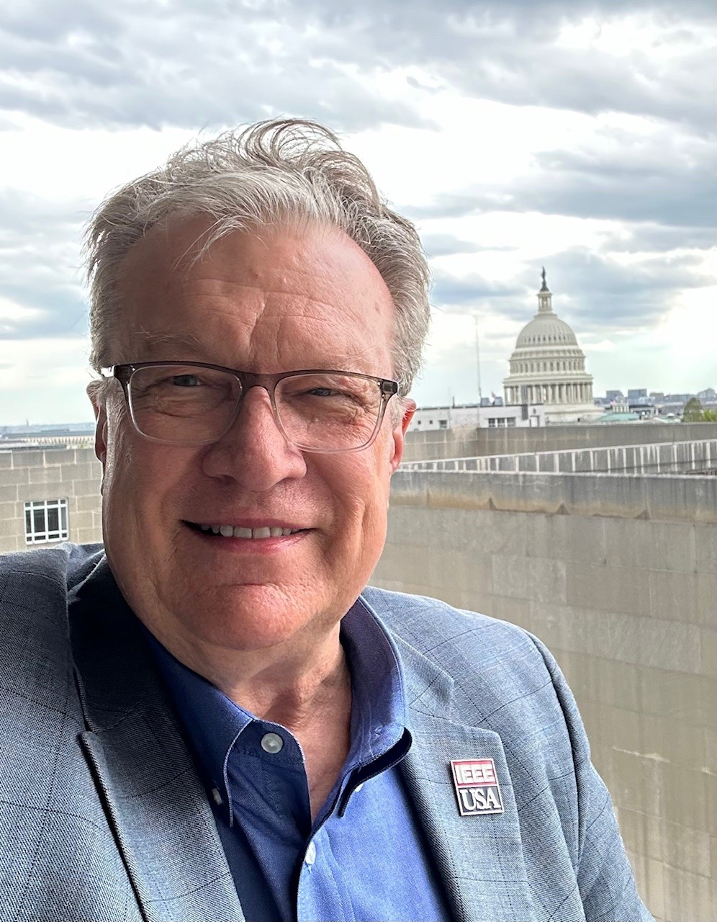
PHOTOS FROM PAST CVDs

Slide 13
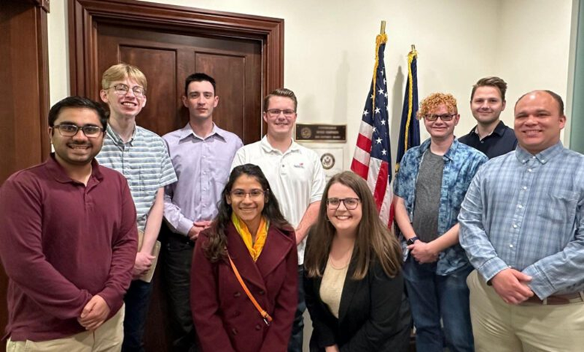
From National to Local
Local Government Relations Events Inspired by the IEEE-USA Congressional Visits Day
IEEE Lone Star Section Legislative Visit Day
Pilot 5 May 2023 (online)
Second event 17 April 2024 (in person)
Met with State Legislators
Planning to make this an annual event
IEEE-USA Congressional Outreach Program (ICOP)
Pilot “Meet Your Local Congressman”
Inaugural event in Idaho Falls on 10 May 2024
Led by IEEE-USA Early Career Representatives
Targeted for students and young professionals
Tailored for the local districts
Rebranded as ICOP
Several events planned for 2025

Slide 14
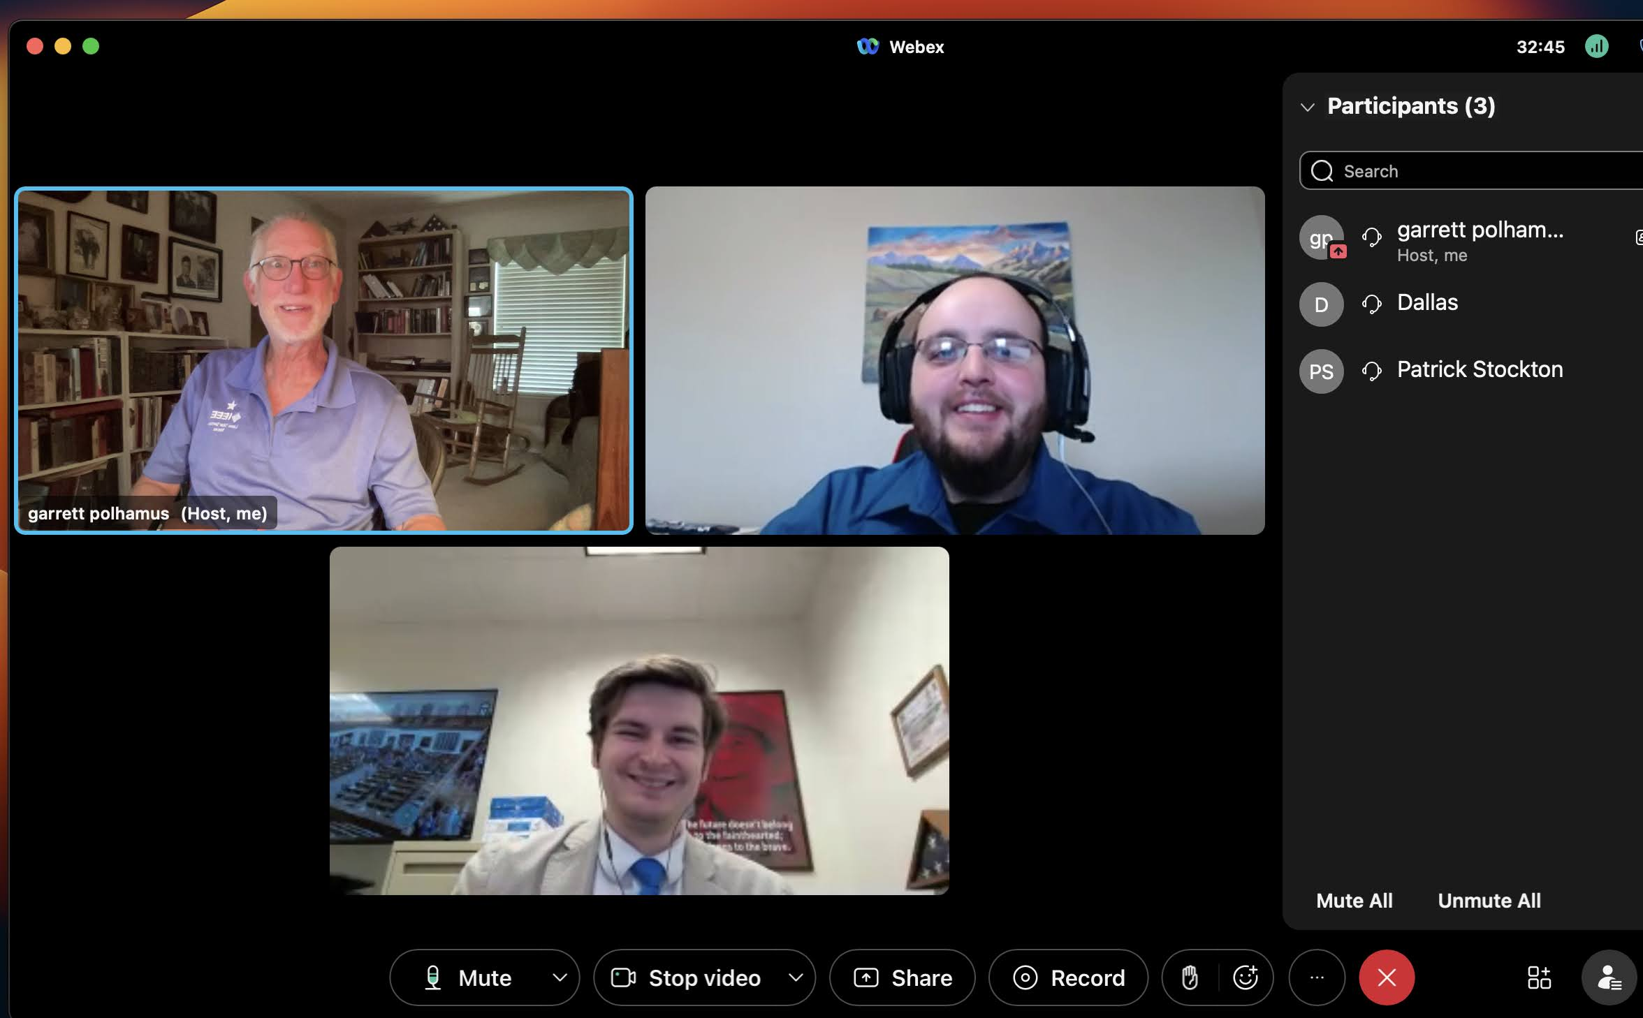
IEEE Lone Star Section Legislative Visit Day
2023 On-Line Meeting with Texas State Legislators – Pilot event
5 May 2023 – Online
Assisted by Russ Harrison (IEEE-USA)
7 Lone Star Section members
Meetings with Legislative Staff Members
Texas State Senator Donna Campbell (District 25)
Texas State Rep. Philip Cortez (District 117)
Texas State Rep. Mark Dorazio (District 122)

Slide 15
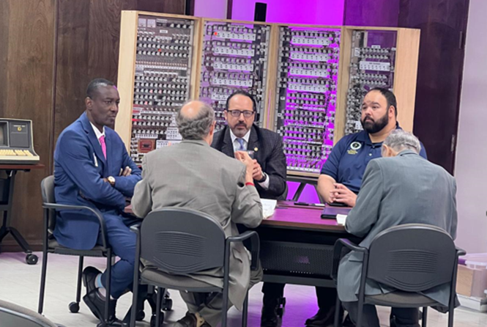
IEEE Lone Star Section Legislative Visit Day
2024 In-Person Meeting with Texas State Legislators
17 April 2024 – San Antonio Museum of Science and Technology
Assisted by Erik Heilman (IEEE-USA)
10 Lone Star Section members
Texas State Senator Jose Menendez (District 26)
Texas State Rep. Philip Cortez (District 117)
Texas State Rep. Mark Dorazio (District 122)
Staffer representing Senator Donna Campbell

Slide 16
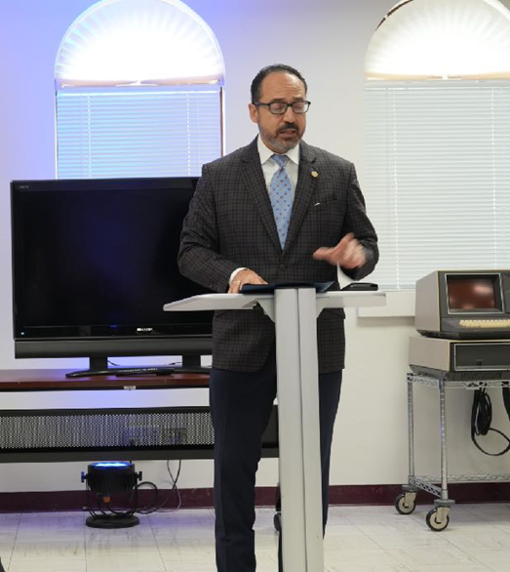
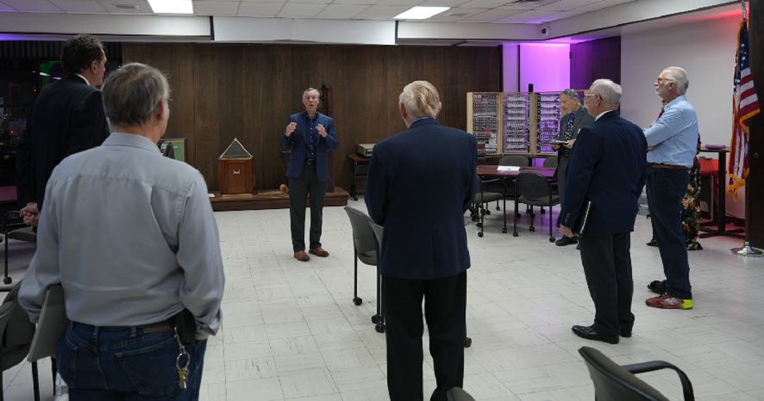
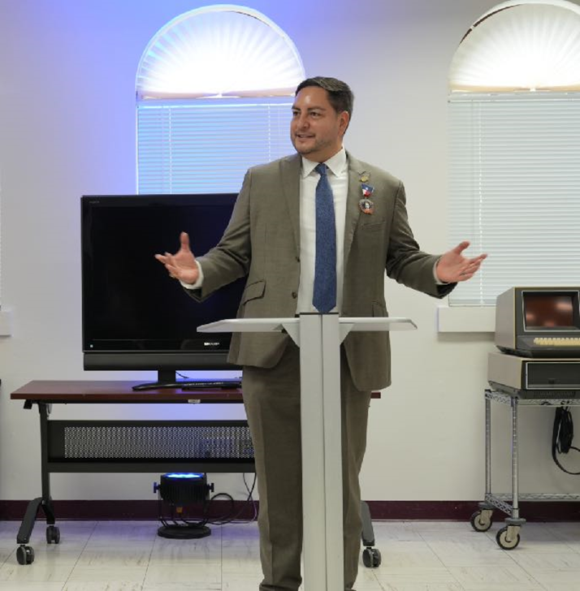
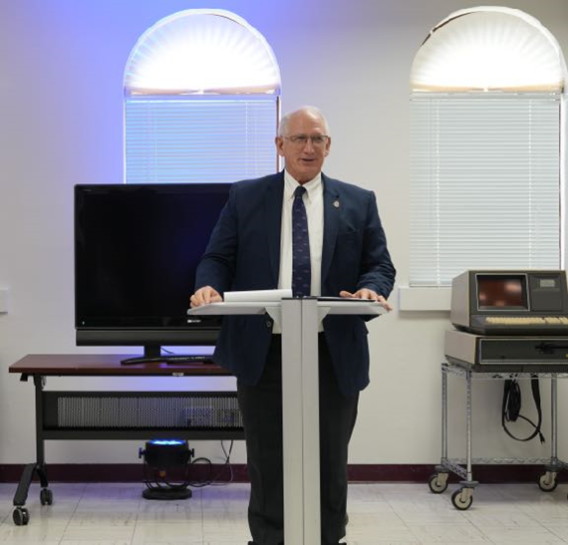
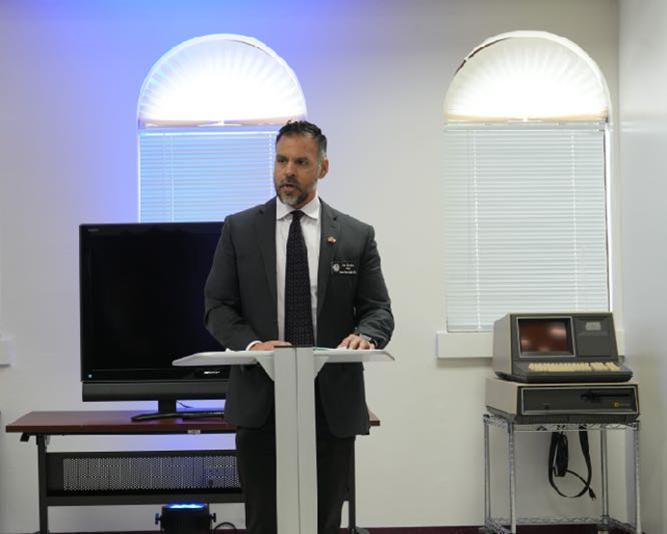
IEEE Lone Star Section Legislative Visit Day
Additional photos from the 2024 event
Senator Menendez
Rep. Cortez
Rep. Dorazio
Mr. Morales
Senator Campbell
Staffer

Slide 17
IEEE Lone Star Section Legislative Visit Day
Meeting with Texas State Legislators – Lessons Learned
Venue is important
Location may facilitate participation (State Capitol or Local District Office)
When meeting with multiple legislators at a time, pick a public place that helps focus on the message (e.g. SAMSAT)
Online meetings are possible, but in-person meetings are better
Timing is critical
Scheduling is difficult during legislative session
Discussions should be relevant to current issues under consideration
Participation
Most likely to meet with staffers (especially during session)
Meetings must include IEEE members living in invited legislators’ districts
What are we asking them to do/support?
We are not lobbyists
IEEE-USA position papers help guide the discussion
Establish contacts for future discussion/advice on technology-related issues
Working on plans for 2025 event after legislative session

Slide 18
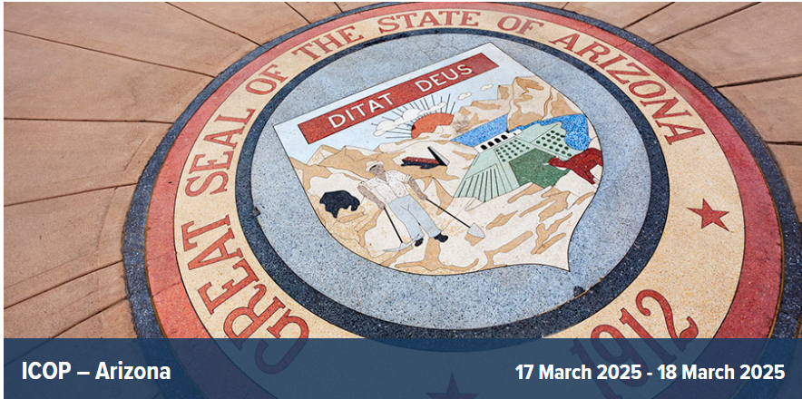
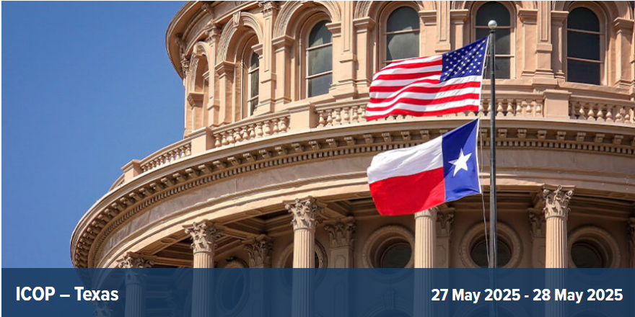
IEEE-USA Congressional Outreach Program (ICOP) – Most recent event and next event

Slide 19
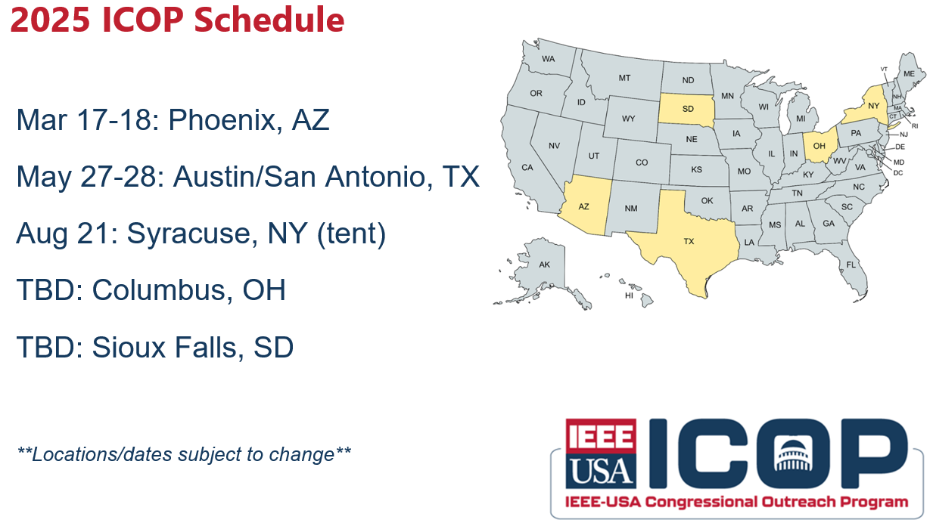
IEEE-USA Congressional Outreach Program (ICOP) – Events planned for 2025

Slide 20
Questions/Discussion

