Slide 1
Industry Engagement Go Where There is Interest
Tim Lee, IEEE-USA President
R5 AGM Panel
29 March 2025

Slide 2
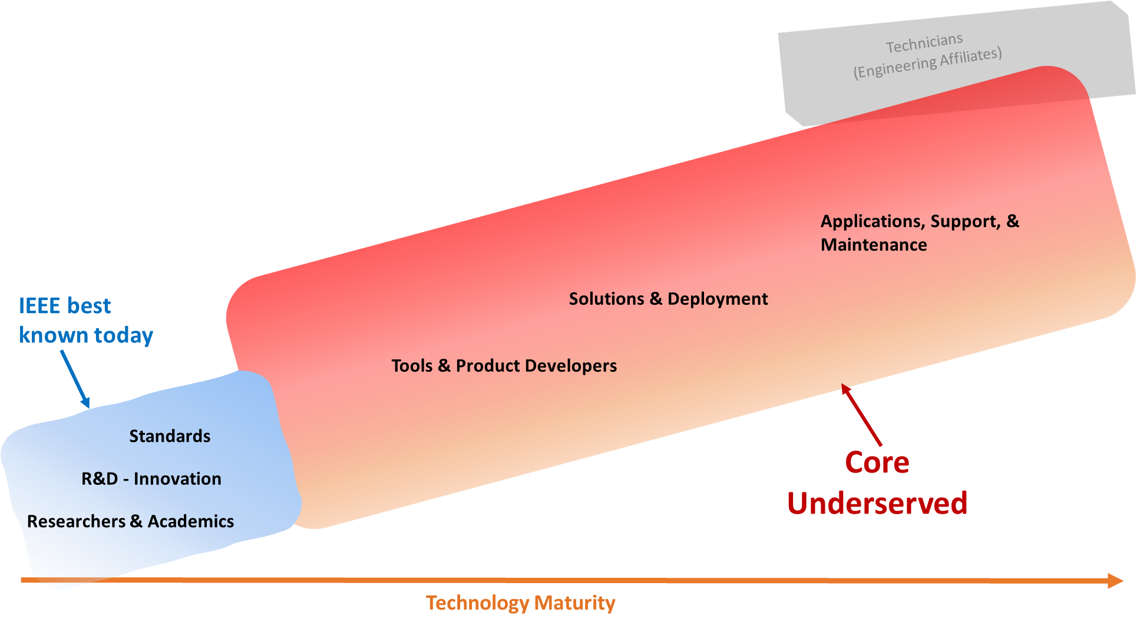
Industry Professionals’ Needs Across Verticals
Building Tech Communities
Tech Corridors
Rural Areas
Tech Policy Across Sectors
Career Development
STEM Pipeline
Transportation
HealthCare
Communications
Semiconductors
Advanced Computing
How can we work together in 2025 to make a difference?
AGI
AI Policy
5G/6G
Comm Policy
Autonomy
Energy Policy
IoT
IC & Packaging
CHIPS, R&D
Industry Engagement need to focus on Verticals
Notes:
The biggest group of industry members are those most closely aligned with academia, that is, those in Research or R&D. We’re largely missing those industry technology professionals who make up the bulk of those in our fields, particularly those in solutions & deployment and those in applications, support, & maintenance.
While we don’t have precise numbers for those in the field for each of these categories (because they were developed by IEC),
Note: the recent All-societies Research Project* has data on this question specifically, which shows that. For that question, looking at the members in industry who responded to the survey, more than half were in either R&D (47%) or Research and Academics (6%). The rest were relatively evenly spread across the other categories.
The question in the member database on whether they spend 50% or more of their time on Research also suggests that a high percentage of our members are in these first two categories – with close to 40% saying they spend 50% or more of their time on Research.
* The All Societies Research Project is a survey that has been done every four years the past 12 years and includes samples from every society.

Slide 3
Meet Industry Professionals Where They Want to Go
We tend to create “Industry Events” organized by IEEE and hope that Industry Professionals will show up
In leading IEEE Technical Conferences, this works.
IEEE International Microwave Symposium
Huge trade exhibition and industry-driven technical program attracts 10,000 attendees
However many IEEE conferences are highly academic with no attraction for industry
Alternative is to go where they meet
Co-located IEEE events pre-, post- to leading industry events
Ie. CES, Mobile World Congress, etc
Vertical Industry Events

Slide 5
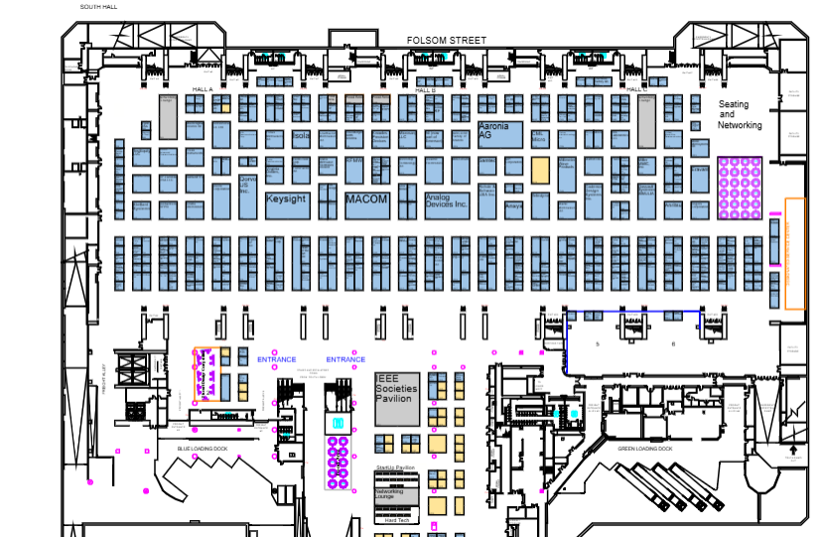
IMS Industry Focus
Systems Program Tracks
Trade show with more than 600 exhibitors
Connect with 9,000+ members of the RF and Microwave community from across the globe.
Build visibility for your company, brand, and products.
Introduce new products and services.
Measure success with lead retrieval and a validated third-party attendee audit.
Industry Workshops
Startup Pavillion
Moscone Center -

Slide 6
Teaming with Plug and Play Tech Center
Open Innovation
We began running startup accelerator programs and focusing on open innovation by partnering with major corporations, governments, investors, and universities.
Based in Silicon Valley
Expansion into multiple Tech Centers and Industries

Slide 7
NeoCity, Florida – Semiconductor R&D Hub

Slide 8
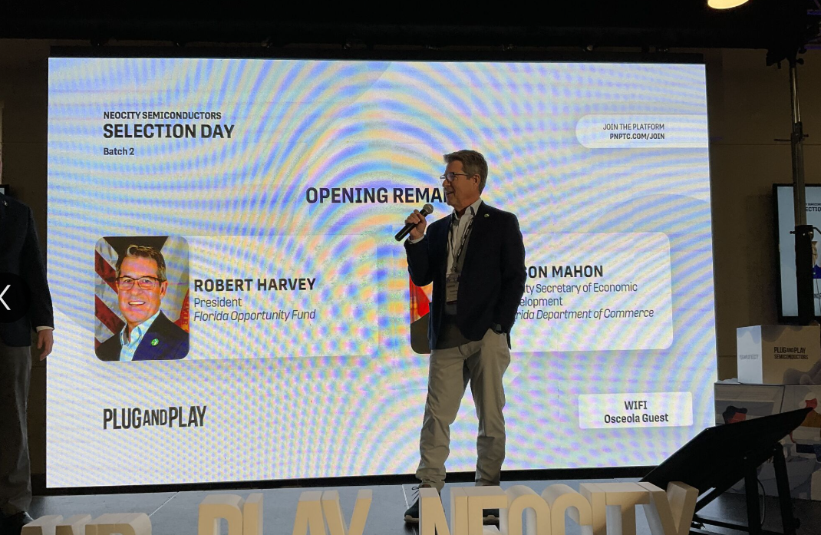
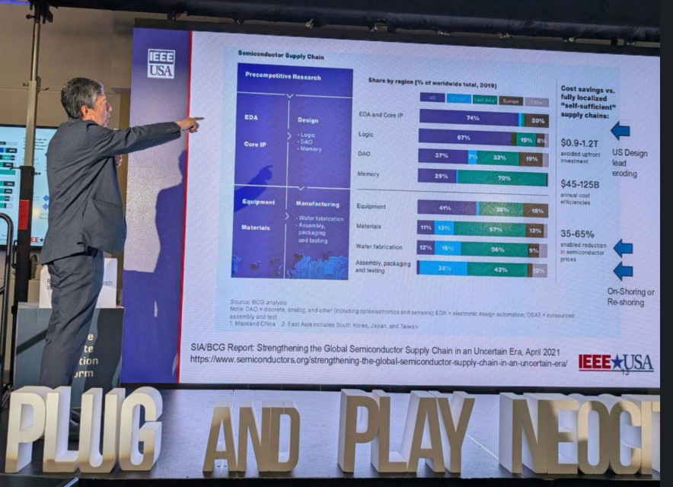
Play and Play Tech Center – NeoCity Startup Pitch Day
Hosted over 100 investors and industry leaders at Plug and Play NeoCity’s Selection Day! We had the privilege of welcoming some of the most promising Semiconductor, Aerospace, and Defense startups into our ecosystem. These groundbreaking companies are pushing the boundaries of technology, and we’re thrilled to support 20 of them as they grow through our network of corporate partners, mentors, and investors.
Meeting Startup CEO / CTOs where they gather (and not at an IEEE event

Slide 9
Let’s Connect!
Will continue to collaborate with PnP
Tell us what new ideas we should consider
Let’s work together for common goals!
Email: tt.lee@ieee.org
Connect with me on Linkedin!

