Slide 1
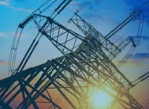
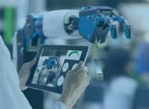
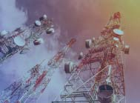
Gerardo Barbosa
2015
IEEE-HKN
2015
Senior Member
2010
Became IEEE Volunteer
2006 Joined IEEE
Some of my IEEE volunteer positions:
IEEE Treasurer (2024-2025)
IEEE New Initiatives Committee (2023-2024)
MGA Treasurer (2021-2023)
MGA Board Vice Chair (2019-2020)
MGA vTools Committee (2018)
Region 9 Treasurer (2018-2020)
Region Conference Coordinator (2016-2017)
Region 9 Technical Activities (2016-2017)
Monterrey Section Chair (2014-2015)
Monterrey Section Treasurer (2012-2013)
Monterrey Section GOLD/YP (2010-2011)

Slide 2
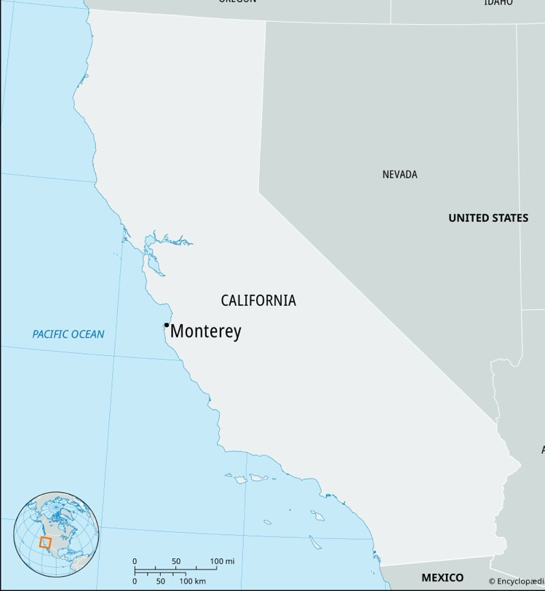
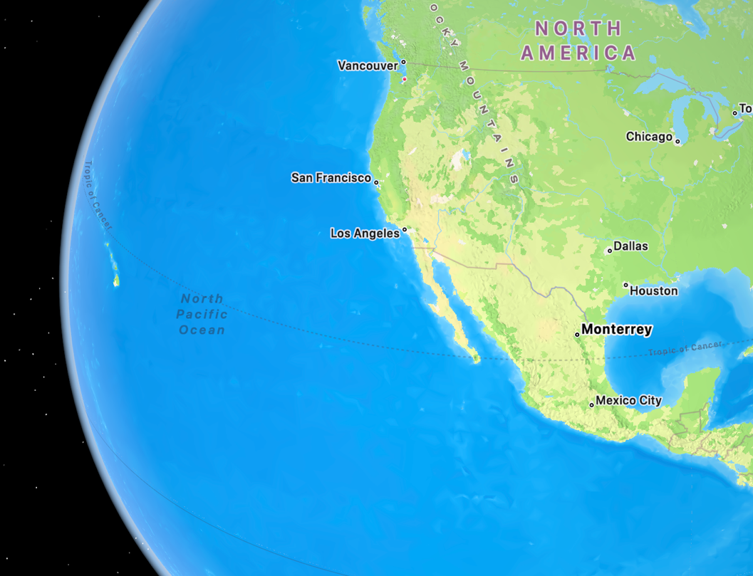
Not this one
This one

Slide 3
2024 PRELIMINARY* ACTUALS
2024 IEEE Revenue: $639.9M
Contrib. to Surplus: $59.3M
Net P.I. Activities: $16.4M
Operating Income: $42.9M
REVENUE
GENERATION
NET SURPLUS & NET ASSETS
Net Surplus: $133.7M
Net Assets: $1,120M
* Unaudited
IEEE PROPRIETARY

Slide 4
Public Imperatives Activities
“Social good activities that are directed at the general public. They are generally related to the promotion of the public’s understanding and appreciation of our fields of interest and/or positioning our technical expertise in ways to benefit humanity. Typically, these activities are not expected to create a financial surplus.”
Updated definition as adopted by the Board of Directors in November 2024

Slide 5
IEEE Finance Operations Manual (FOM)
Currently Working on Version 54, work on version 1 began 25 years ago

Slide 6
Thank you
gerardo@ieee.org

