Slide 1
Region 5 Leadership Project
Christopher Sanderson, Director Elect

Slide 2
Region 5 Leadership Pilot Project
Goal: Create a transparent process that encourages the broadest participation of qualified volunteers from the entire region in the leadership of the region
Why?
Taking sufficient time and resource to identify quality candidates
Bring the region inline with other OUs to encourage participation of Region members in higher-level committees and boards
Increase diversity of candidates in terms of geographical participation (by size: small, medium, large; by area: N/S/E/W, by status (YP, member, SM), by affiliation: industry, academia, etc and by general inclusivity and equity goals)
Ease the burden of volunteer candidates for subunits (sections, etc)
#LEADERSHIP

Slide 3
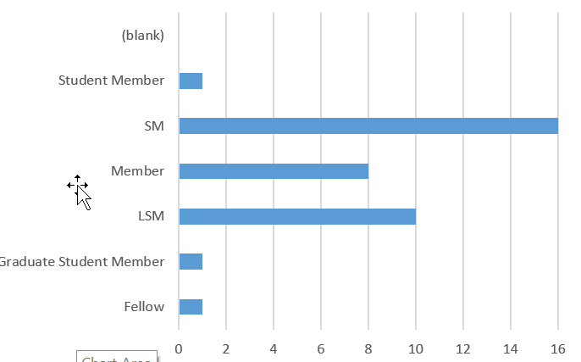
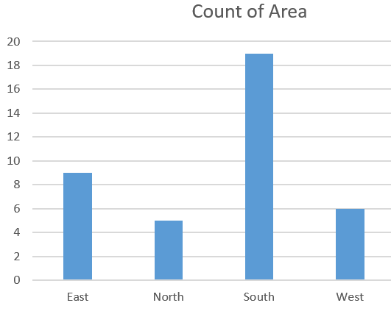
Results - 2024 Leadership Pilot
High retention – only 3 changes so far
Increased area diversity
New members engaged
Sections better engaged
#LEADERSHIP

Slide 4
Openwater N&A Process for R5
Advertise Pilot and Regional Objectives for 2026 term
Accept Nominations
Outreach to nominated (emails)
Openwater Application for Candidates
No later than:
Sep 11
Open: Sept 1
Aug 1
Aug 1
Close: Oct 1
Selection Process
Primary
Slate of R5 chairs for 2026
Secondary
Candidates for subcommittee members
Candidates for section-level opportunities

Slide 5
Goal
EVERY SECTION REPRESENTED!

